Slide 1
Durability Monitoring [Country]
Training for 12/24/36 month follow-up Survey
Finding Households with GPS

Slide 2
Finding all Households
It is critical that an outcome is determined for all and recorded on the tablet PC
Found, Nobody home (but HH still there)
Found, consented and interviewed
Found, but refused
Not found, moved away (outside settlement)
There are two tools available to assist in identifying all previously sampled households
Household lists by cluster
Mapping tool on tablet PC with GPS location of each house

Slide 3
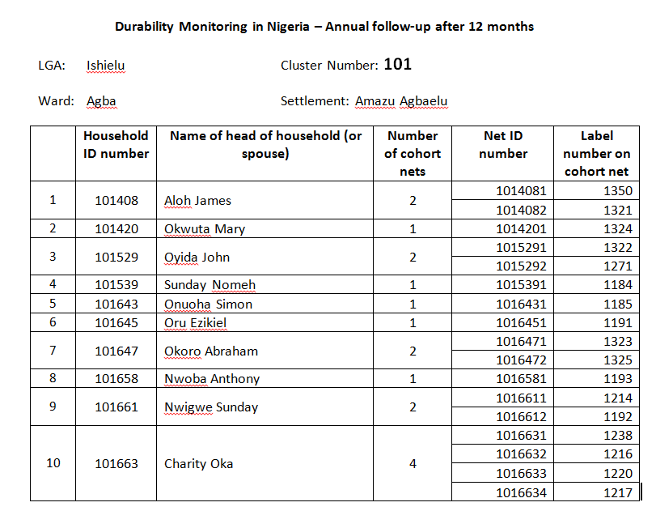
Household listing
HH ordered by number
Total number of HH in cluster

Slide 4
Open source mapping and navigation software “Open Street Map for Android”
This version works offline, no need for telephone or internet connection, but device needs to have GPS capacity
Remember that to show your own location the tablet needs to connect to at least 3 satellites to find your position (within ~5-10 m)
Does not work inside!

Slide 5
Click on Osmand symbol to open Application

Slide 6
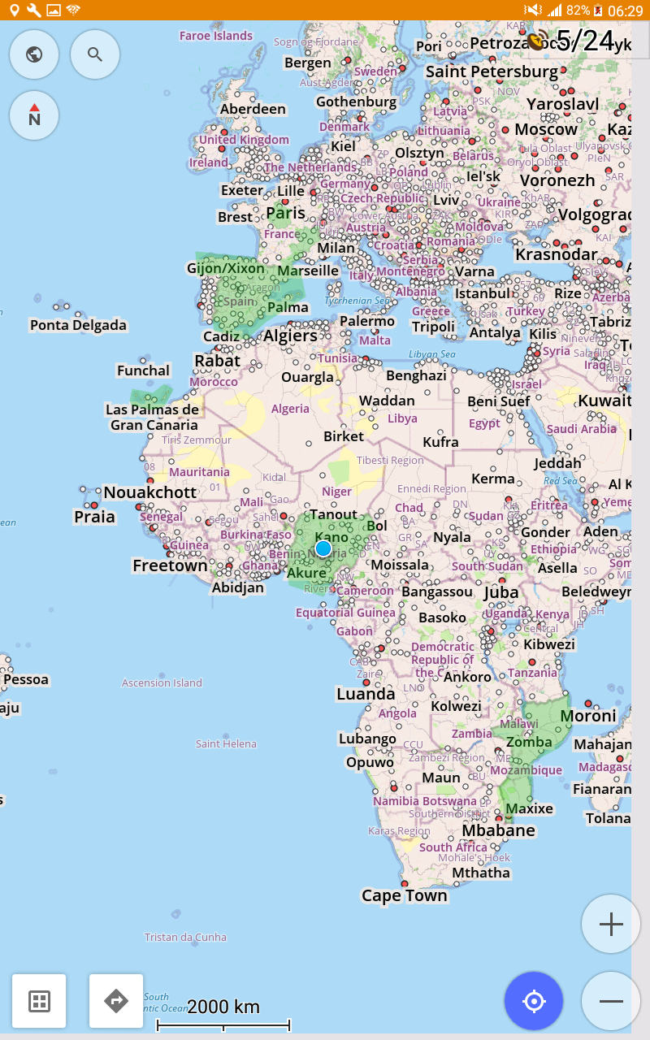
Household listing
Menu
North
Your location
Jump to your location detail
Zoom in and out

Slide 7
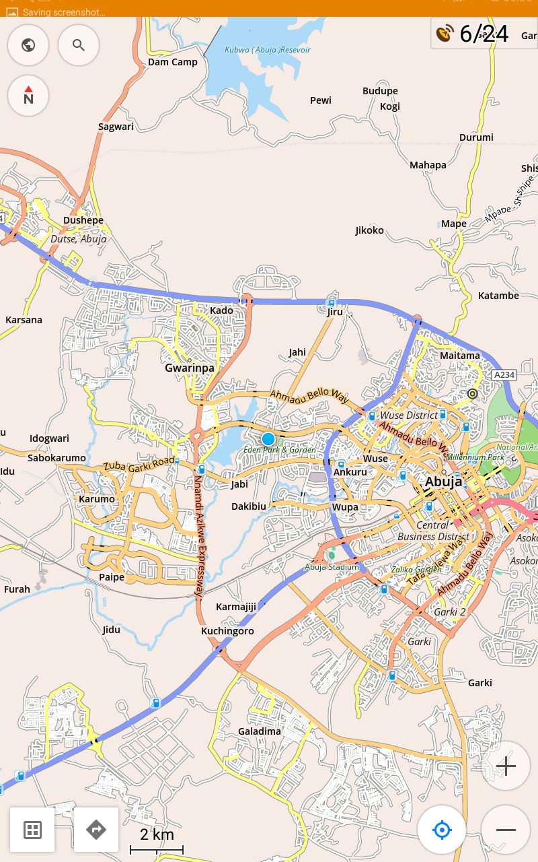

Slide 8
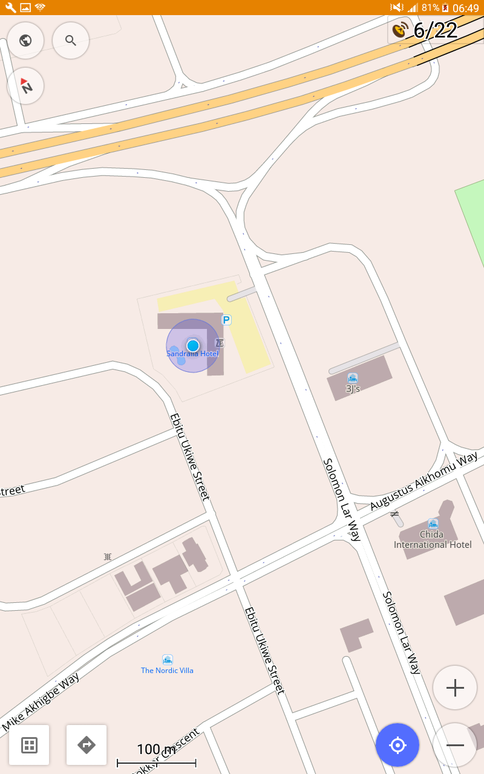
North
Accuracy of GPS
Scale

Slide 9
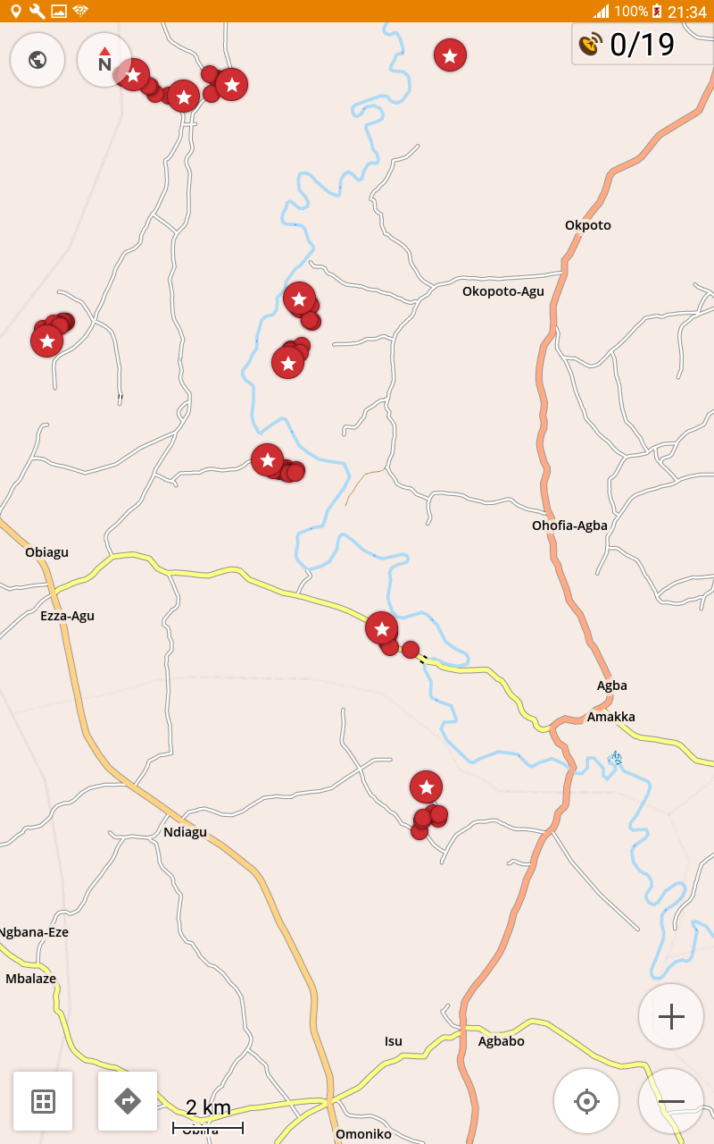
Example from Ebonyi
Clusters with HH

Slide 10
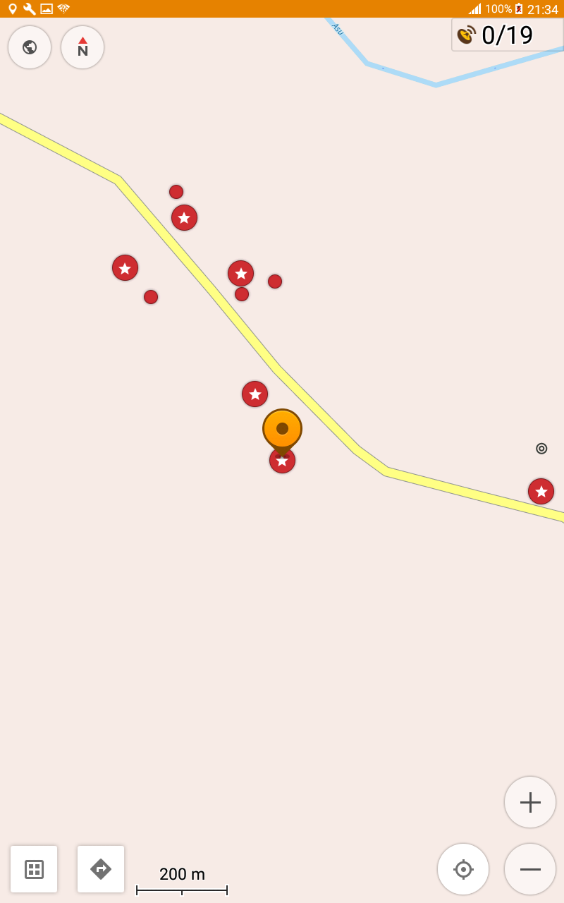
Example from Ebonyi
Click on HH

Slide 11
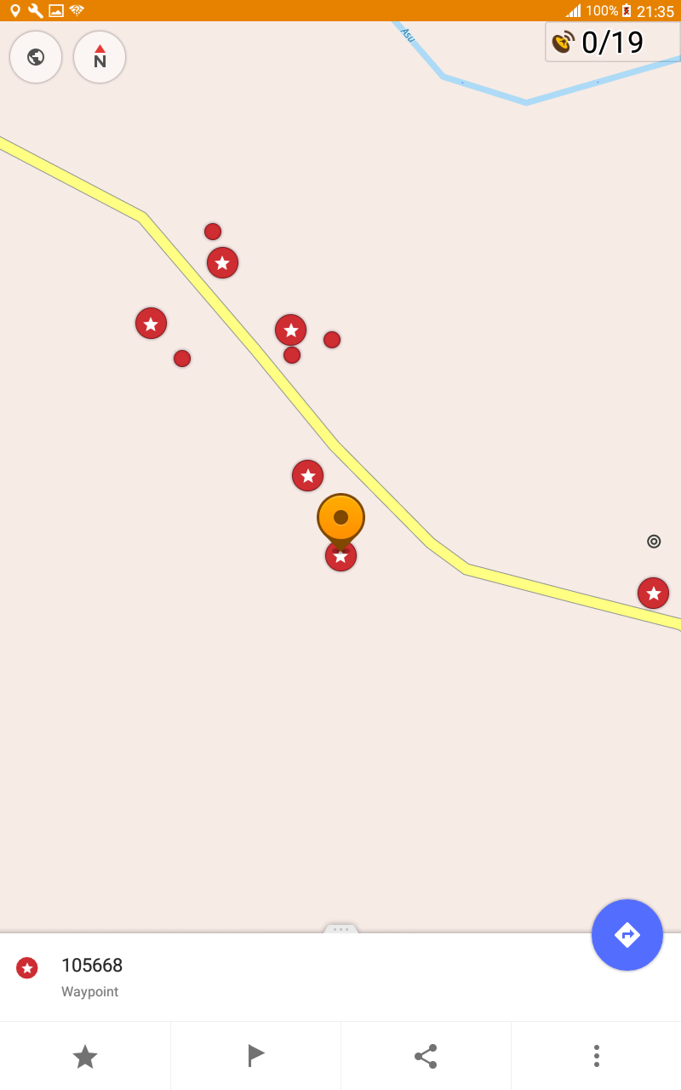
Example from Ebonyi
HH number will appear,
Click on red dot…

Slide 12
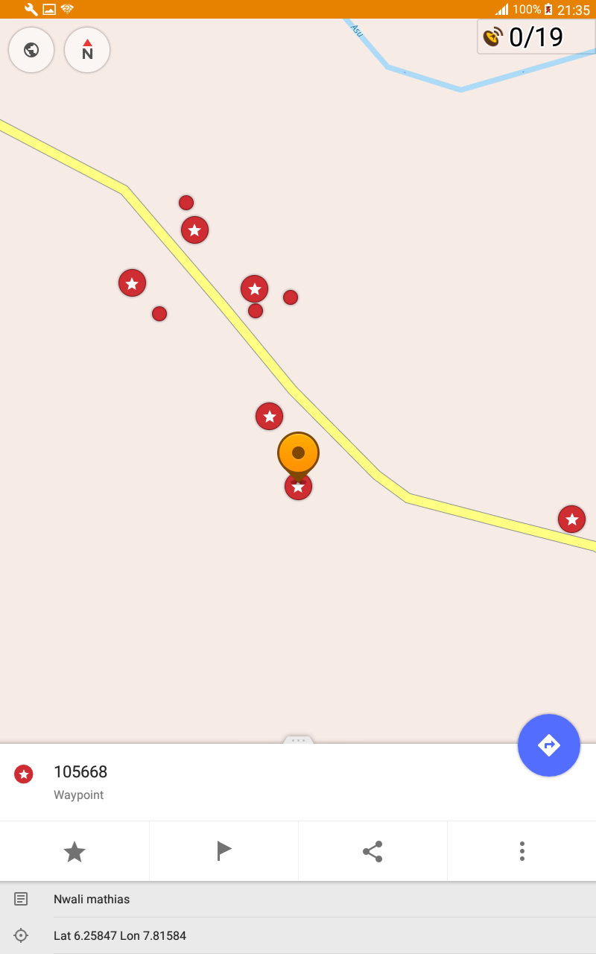
Example from Ebonyi
Name and GPS will appear

Slide 13
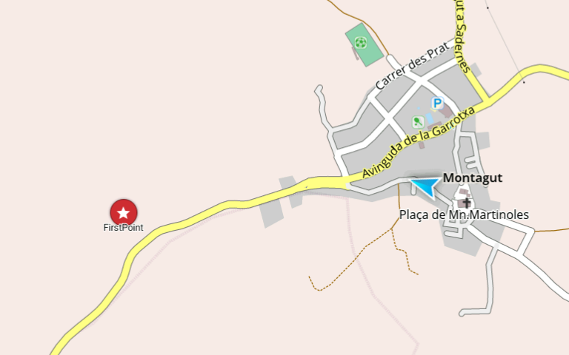
Process in the field
From list and map decide on the best order of visiting households
You can see your position and an arrow as you move
This will assist to find the route to the house (if you need it)

Slide 14
Exercise
We have identified four locations around the training site
They are named “point 1” to “point 6” and have names
Divide into groups and go find the points
Group 1 starts with point 1 etc.
Then move to the next point nearest to you

