Slide 1

LLIN Durability Monitoring
Monitoring Design & Protocol
Notes:
This presentation will cover the overall study design and the study protocol.

Slide 2
Overview
Some background survey methodology
Exercise on sampling
Monitoring design
Notes:
We’ll cover background on survey methodology, go over an exercise on sampling, and review the study design.

Slide 3
Objective of Surveys
To obtain a representative estimate of the indicator of interest from the population at risk (or of interest)
….an unbiased picture of the “truth” without having to look at everybody or everything
Myth:
In order to be representative I need to include at least x% of my study population……..
Notes:
Our objective is to obtain a representative estimate of our primary indicator from our population of interest. We want to get a picture of the ‘truth’ which is unbiased, without having to interview all of the people and look at all of the nets in this area. There is a myth that a certain percentage of the population is the minimum for getting to be ‘representative’. This is not true! It is a little more complex than that.

Slide 4
Two Concepts
Accuracy
Precision
Is it an accurate picture of reality ?
How precise is my estimate ?
Representativeness
Repeatability
Notes:
We have two goals or concepts. First, accuracy. Does our design give us an accurate picture of reality? If it does, then it is “representative”. Second, precision. How precise is my estimate? If I do the study again, will I get the same result (or pretty close)? This is what we call ‘repeatability’.

Slide 5
Two Concepts
Accuracy
Precision
Truth
Accurate but not precise
Precise but not accurate
Precise and accurate
Notes:
So to illustrate, we have some bull's-eyes/targets here. The truth is in the very middle. The 1st target has some dots around the edge of truth – these are accurate (close to the truth), but they are all around, so they are not precise. On the right we have a cluster of dots in the edge of the target – they are precise, getting the same ‘answer’ each time, but not very close to the truth, so not accurate. In the middle we have a nice cluster of dots right in the middle – both precise AND accurate. This is what we are looking for.

Slide 6
Two Concepts
Accuracy
Precision
Is it an accurate picture of reality ?
How precise is my estimate ?
Representativeness
Repeatability
Sampling
Sample size Variation
Notes:
So how do we make sure we get both accurate and precise results, and that our sample is representative and repeatable? We obtain representativeness through our approach to sampling. And our sample size will dictate how precise and therefore repeatable our estimates will be.

Slide 7
Precision
Sample size
  The higher the sample size the better the precision
  Statistical significance does not always mean programmatic significance
  Even very small samples can be useful (LQAS)
Notes:
We’ll take sample size first. Generally, the higher the sample size, the more precise our estimate will be. We will be able to detect very small differences as ‘significant differences’. However, statistical significance is NOT the same as programmatic significance! One example is in a recent very large household survey, there was a significant difference detected between % of households registered for a campaign – 86% compared to 90% in two areas. While it was a statistically significant difference (because the sample size was so large), the finding that the difference was statistically significant wasn’t going to lead program planners to change their approach very much in those two areas for household registration going forward. That difference is not programmatically significant, in other words.
Likewise, even very small samples can be useful. With a sample size of only 19, LQAS (lot quality assurance sampling) is used to determine whether a batch of factory-produced items meet quality standards. The estimates produced are NOT precise, but they are useful for knowing whether the batch meets or does not meet a certain threshold.

Slide 8
Accuracy
Sampling
  If the studied items were homogeneous any sampling method will be accurate
Notes:
In terms of accuracy, if all our houses have the same number of nets and the nets have all the same number of holes, it doesn’t matter what sampling method we use – any method will be accurate!

Slide 9
Accuracy
Sampling
  But because they usually are not sampling is so important
  Ideally one would have a complete list of all study objects (sampling frame) and directly selects from the list the needed number
  If that is not possible sub-units of study objects can be selected (clusters)
    Health facilities
    Villages
    Schools
  Two-stage cluster sampling
Notes:
But usually houses and nets differ – and therefore sampling is critical. Ideally, we would have a complete list of all the objects (households) in the study – what we call a sampling frame. From that list we could directly select the houses that we need to meet our sample size requirements. However, these lists don’t usually exist either – there is no central list of all the houses in this province, right? So we use something called two-stage cluster sampling, where first we have a list of clusters – which can be health facilities, villages, schools, for example, and we select from that list. Then within that cluster, the second stage we make another selection.

Slide 10
Cluster Sampling
Use two steps to first select the clusters (stage one)
And then the study objects in cluster (stage two)
Notes:
Cluster sampling is therefore using two steps – first select the clusters, and then the study objects (households) within that cluster. Those are the two stages of two-stage cluster sampling.

Slide 11
Stage One
Whenever possible the first stage should be done from some kind of list using “Probability Proportionate to Size” or PPS
  Need list of clusters and any measure of size
  PPS is a systematic sampling which allocates more units where more people are living
Notes:
To select the clusters, we need to take into account that some clusters will be larger than others – some districts have more people, some have less. So we use something called “probability proportionate to size” to do this, where we have a higher likelihood of selecting a cluster that has more people in it.

Slide 12
Stage One
Another common method of selecting clusters by simple random sampling (SRS) from a “cascade” of administrative units can be very misleading if variable of interest is inhomogeneous
IT SHOULD BE AVOIDED IF AT ALL POSSIBLE
Notes:
Simple random sampling is another common method, but should be avoided for cluster selection, unless all the clusters are exactly the same – which we already know they are not.

Slide 13
Stage Two
Within the cluster the required number of units need to be selected (Primary Sampling Unit, PSU)
If at all possible this should be done from a list of all eligible units either prepared on the day of survey or just before
Selection then done by simple random sampling (SRS) or systematic sampling
Other methods such as “random walk” or “spin the bottle” should be avoided
Notes:
Once we have the clusters selected, we need to then select the Primary Sampling Units (PSU) – these are the households. It’s important to establish a list of all the eligible households just before the survey, not use an old list of the households in the area, as new ones may have appeared or others left. Once that current list is established, selection of the study households can be done using simple random sampling or systematic sampling. Other methods, like “random walk” or “spin the bottle” are very biased, and SHOULD NOT BE USED. Now I’ll demonstrate why that is.

Slide 14
Sampling within Cluster
“Spin the bottle” method to find index house and the next nearest
SRS from complete household list from leaders or after mapping (GPS)
Notes:
Here we have the same cluster, which we’ll sample in two different ways – one with simple random sampling after making a complete list of all the households, and one with the spin the bottle method.

Slide 15
Sampling within Cluster
“Spin the bottle” method to find index house and the next nearest
SRS from complete household list from leaders or after mapping (GPS)
Notes:
The SRS approach gives us a random sample of the households.
Random walk and spin the bottle are methods where a starting point is chosen or established (e.g. by spinning a bottle to point at a house or direction), and then every 3rd or 5th etc household along that line is selected for interview. It is biased towards the center of town, which we know to be very different from households further out.

Slide 16
Sampling within Cluster
“Spin the bottle” method to find index house and the next nearest
SRS from complete household list from leaders or after mapping (GPS)
Notes:
Houses that are closer together are more likely to be the same, and may not be similar to households that aren’t selected. Perhaps there is a road going through a part of town, or a lake, or river – perhaps that side of the village is poorer or richer. These differences introduce bias to our results, making them less accurate.

Slide 17
Summary: Sampling
Sampling is the most critical step in surveys to achieve accuracy and should not be neglected
If at all possible sampling should be done from a list of clusters using PPS (stage one)
Within the cluster study objects (PSU) should also be selected by random or systematic sampling (no random walk!)
Notes:
In summary, sampling is the MOST CRITICAL step to achieve accuracy – it cannot be neglected, nor shortcuts taken. We use PPS sampling to establish the list of clusters for the study (stage one), and then within the cluster, we use random/systematic sampling to select the households – NOT random walk.

Slide 18
Monitoring Design

Slide 19
Study design of LLIN Durability Monitoring
Prospective cohort study to determine physical survival of LLIN from campaign
Durability =
# of nets still there and fit for use at time x
# of nets originally received and not given away
Difference in physical condition (% still good and % too torn)
Notes:
So in this study, we’re using a prospective cohort study to investigate the physical durability of LLIN from the recent campaign. Durability is defined as the # of nets that are still present and fit for use, divided by the # of nets that were originally received, and not given away. The difference we’re looking at is physical condition – the percent that are still ‘good’, and the percent that are now ‘too torn’.

Slide 20
Durability monitoring timeline
Baseline
0
6
12
24
36
Distribution
Assess
Attrition
Integrity
Assess
Attrition
Integrity
Assess
Attrition
Integrity
Assess
Attrition
Integrity
Notes:
Here is a diagram of a prospective cohort study. The first circle represents the mass campaign. Shortly after the distribution, we sample the net cohort – the group of nets distributed – and we “establish the cohort” that we will then track over time. Each year after the mass campaign we assess (yellow dots) the cohort of nets to see what condition they are in and how many are still there. This goes on for 3 years.

Slide 21
Protocol
For each site 15 clusters selected from census data in two steps
  Selection of cluster location by ward with PPS
  Selection of settlements within ward by SRS
Selection of clusters and households remains valid throughout study
Notes:
In our protocol, we’re comparing three study sites, and in each site we’ll select 15 clusters – we select the clusters (wards) using probability proportionate to size, and then the settlements within the ward are selected using simple random sampling. Our selection of clusters and households remains the same for the entire study.

Slide 22
Protocol (2)
Households within settlement selected by SRS from random number lists based on listing of all households
Only households which had received any nets from campaign in XXXX are included (even if these are now gone)
Replacement households are selected for those not eligible
Households maintained for each survey round
Notes:
Then within each settlement, we enumerate (list) all the households, and select households using simple random sampling. For this study – very important – only households that received any nets from the campaign in XXXX are included! Households that didn’t receive any nets from the campaign are not eligible. A household that received nets from the campaign, but doesn’t have them now, they are still eligible. [check for comprehension]. If a selected household is visited and found to not be eligible, it is replaced. For every subsequent study round, the same households are visited.

Slide 23
Protocol (3)
Household interview to
  Characterize household’s socio economic status (wealth quintiles)
  Determine fate of campaign nets (attrition) and reasons for loss
  Exposure to messages and perceptions
  Care and repair behavior and attitudes
  Details of existing campaign nets including their condition (integrity)
Notes:
Then, once the selected household is confirmed eligible, the household interview is conducted. We’ll go over the questionnaire later, but it covers information about the socio-economic status and characteristics of the household, so that we can then establish wealth quintiles for analysis, it covers what happened to the campaign nets received by the household and why they were lost (if lost), exposure to communication messages and perceptions, household attitudes towards care and repair, and behaviors, and details on the existing nets – their type, shape etc, and their condition, in particular the size and number of holes. All that will come later. For now – thank you!

Slide 24
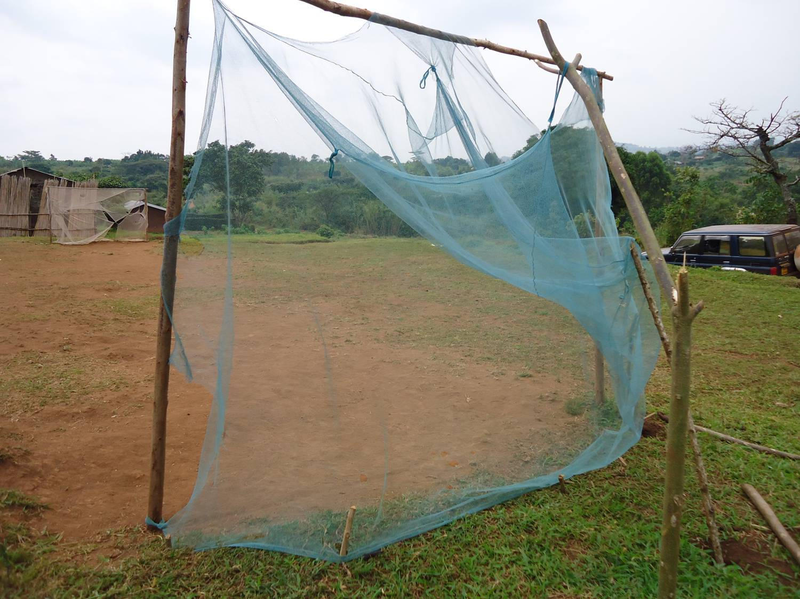
Thank You

