Slide 1

LLIN Durability Monitoring
Overview of Questionnaire
Notes:
This presentation gives a general overview over the structure of the questionnaire and highlights some general rules of filling in the responses. It is intended to be given before a step by step walk-through of the questionnaire and role playing

Slide 2
Elements (sections)
Identification and consent
People in the household
Household characteristics and net ownership
Care & repair behaviors and attitudes
Nets lost from the household
Campaign nets owned by the household
Other nets owned by the household
Notes:
The baseline questionnaire (when the cohort of campaign nets for monitoring is established) has six distinct setions as follows:….
Note that in the annual follow-up rounds section 4 will be dropped and the relevant questions integrated into section 5 for each of the cohort nets.

Slide 3
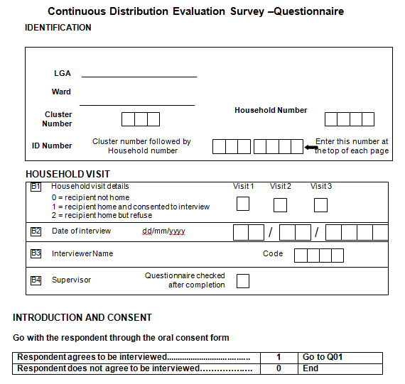
Identification
Notes:
The identification section is the most imprtant part of the questionnaire because without it all the information collected will be useless for the analysis and hence cannot contribute to the research.
Recording of the locality (in this example from Nigeria the Local Government Area [LGA] which corresponds to a district and the Ward or county will help to clarify the location, but the most important item is the ID number for this particular questionnaire. This numner is composed of the cluster number (the number for the village or community) and the number of the individual household (obtained from the listing of all households in the village)…. This is explained in more detail in the “household selection presentation”.
The second section records the history of contacting the selected (sampled) household and always needs to be filled, even if the response was a refusal or no presence after three attempts to contact.
After the identification you go through the consent script (discussed elsewhere) and if consent is given proceed to do the actual interview.

Slide 4
Basic Structure
Tela
HH
Tela
People
Tela
Tela
Lost nets
Tela
Tela
Nets
Campaign and others
Notes:
The principle unit of observation for the questionnaire is the household or specifically the household respondent, i.e. answers generally refer to the total household. There are, however, three section where the unit of observation changes namely:
The list (roster) of household members where each row refers to an individual that lives in or is visiting the household
The recording of fate and reasons for loss for any campaign net no longer owned by the household where responses are recorded for each lost campaign net
The details of all the nets currently in possesion of the household where the net is the unit of observation. This part is subdivided into a section that looks at all campaign nets and one that deals with all the other nets (from other sources than the campaign.

Slide 5
General Rules to fill questionnaire
Do not read out response options
Assist respondent in correctly recalling events etc.
If response not listed in options, mark closest or if very different “other”
Follow the indicated skip pattern
Always clearly mark responses.
Notes:
Some general rules regarding the filling of the questionnaire are the following:
Never read out loud the options of the question to the respondents. Rather listen to what he is saying and and based on that response mark the corresponding option in the questionnaire
If the question involves things that happened in the past and the respondent cannot immediately recall, assist in talking him/her through the event to facilitate correct recall
In case the response given does not directly match the options in the wording in the questionnaire tick the option that is closest to the response, i.e. that is identical from the meaning or content even the respondent phrased it differently. If the response does not fit in any category, i.e. very different from any options stated, then mark the “other” option
Pay close attention to the skip patterns, i.e. the instruction in the questionnaire where to go next depending on the responses obtained (this does not apply in data collections with digital devices)
Always mark the questionnaire clearly so that the data entry staff can have no doubt what the response was

Slide 6
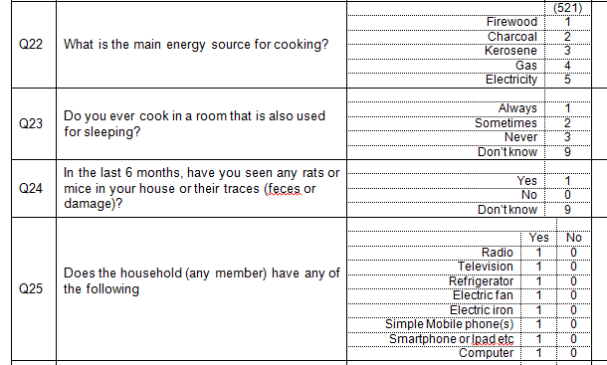
General Rules to fill questionnaire
Notes:
Responses should always be marked by encircling the option on the questionnaire rather than making a “tick” as this is easier to read for the data entry staff. Especially in multiple yes/no questions as demonstrated here in Q25, it is very important to mark also all the negative answers so that there is no confusion whether or not the question was actually asked (leaving it blank is NOT the same as saying it was negative.

Slide 7
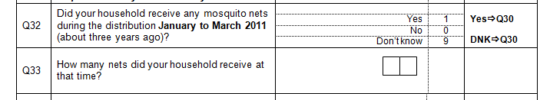
General Rules to fill questionnaire
No ⇨ Q34
DNK ⇨Q34
0 3
Notes:
This example shows a skip pattern. The rule is that if there are no specific instructions, you go to the next quation in line. So if the response to Q32 is yes (as in this case) nex next question is Q33. If, however, the response was No of DNK, then the skip pattern instructs you to go directly to Q34 and skip question 33 (as it does not apply in that case)

Slide 8
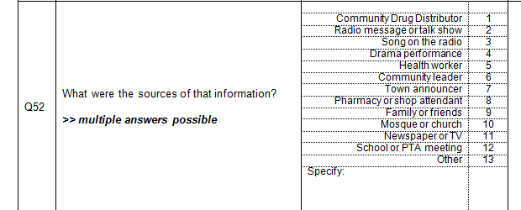
General Rules to fill questionnaire
Notes:
Some questions are marked as “multiple answers possible” like in this example. This means that we can expect more than a single response and all distinct responses need to be recorded (the order does not matter). As mentioned before, it is important, that the options are NOT read out loud to the respondent and that you listen carefully and mark any option that applies. In this example we are asking about where a person has heard messages about nets and their care and repair and the respondent may tell us spontaneously where he/she recalls to have heard such messages. However, you should always follow-up asking like “do you remember any other source” to ensure that we capture as complte an answer as possible.

Slide 9
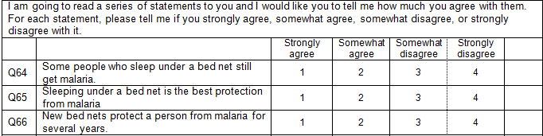
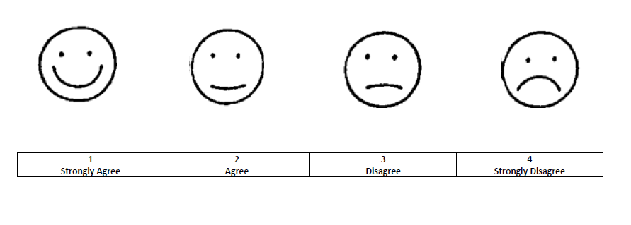
General Rules to fill questionnaire
Notes:
In the questionnaire there are some questions where a statement is read to the respondent and he/she is asked to state to which degree he/she agrees or disagrees with the four possible options shown here. Some respondents may have difficulties with the answers. You can help them by reading the statement again very slowly (and if necessary explain in your own words what it says) and then show him/her your “smiley face card” and ask, which state of mind best captures his/her response or reaction to the statement, from very “happy” to very “unhappy”.

