Slide 1

LLIN Hole Assessment Training for Surveyors

Slide 2

Monitoring Holes in Mosquito Nets
Notes:
Image SarahHoibak / UNHCR Dadaab Refugee Camp, 2011
LLINs are an effective way to protect from malaria transmission. Their effectiveness is impacted by their chemical (insecticide) and material (physical) durability. This training is to teach how to measure the physical durability of the LLINs.

Slide 3
Training Objectives
Accurately and thoroughly count the number of holes in LLINs
Measure the size of each hole using the Hole Assessment Template
Systematically record the number and size of holes on the Hole Tally Sheet
Understand the survey team roles and responsibilities during the process of assessing LLIN fabric integrity

Slide 4
Training Agenda—Day 1
Session |  | Duration
 | Introduction to the Training | 40 min
 | Introduction to Net Hole Assessment | 40 min
 | Break | 15 min
 | The Hole Assessment Template | 1 hour
 | Lunch | 1 hour
 | The Hole Tally Sheet | 1 hour
 | Assessing LLINs Practice | 3 hours

Slide 5
Training Agenda—Day 2
Session |  | Duration
 | Review of Day 1 | 45 min
 | Break | 15 min
 | Field Practice—Net Hole Assessment | 2 hours
 | Lunch | 1 hour
 | Field Practice—Net Hole Assessment | 3 hours
 | Review of Field Practice | 1 hour

Slide 6
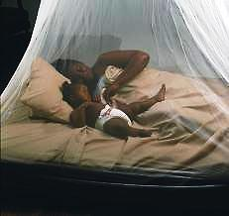
Review of LLIN Durability Studies

Slide 7
Durability Studies
Knowledge about the durability of LLINs after distribution is needed in order to estimate:
  Rate of replacement in continuous distribution systems
  Appropriate interval between campaigns
  How to help improve products in the future
  Which LLIN product is best suited to the specific context
Notes:
From Albert Kilian presentation “LLIN Durability: Concept and Methodological Approach” 2010

Slide 8
LLIN Durability Monitoring Study Design
Prospective longitudinal —nets are followed at regular intervals from the time of distribution until a defined end-point of usage
Surveyed periodically over time
Nets distributed
Future
Present
Notes:
The major objective of the monitoring activity now is to obtain a realistic picture of what happens to the population of nets given out through a campaign and, therefore, statistical accuracy and representativeness of the area of interest e.g province, district, etc.
A sample of nets (cohort) is identified shortly after the distribution campaign and marked with unique identifiers. This cohort is then followed over time in multiple (e.g. annual) surveys.

Slide 9
LLIN Durability Surveys
Assess economic status of households
Include questions related to the usage, fate and maintenance of LLIN
Inspection of the nets

Slide 10
Components of LLIN Durability
  Attrition
    the proportion of previously received LLIN no longer present
    the number of nets lost to damage or given away
  Physical Integrity
    counting the number of holes in the net
    counting the number of net holes by their location on the net and their size
Notes:
Insecticidal activity is also a meaurement of LLIN durability but it is not covered in this training.

Slide 11
WHOPES Recommended LLINs
Polyethylene (PE)
Polyester (PET)
Polypropylene (PP)
Notes:
Currently World Health Organization Pesticide Evaluation Scheme (WHOPES) recommended nets are made of Polyethylene (PE), Polypropylene (PP), or Polyester (PET). They are treated with a pyrethroid insecticide and for PE and PP the insecticide is incorporated into the yarn while for PET it is coated on the surface of the yarn.

Slide 12
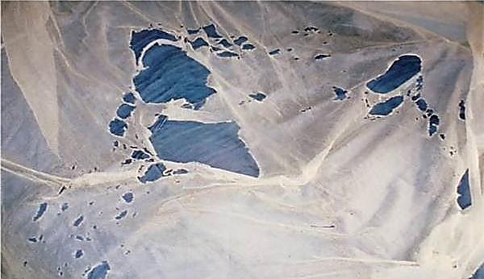
LLIN Hole Types and Categories

Slide 13
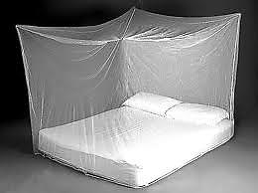

Types of Nets
Rectangular Conical
Notes:
LLINs are either rectangular or conical in shape. The hole assessment questionnaire will have a question about the shape of the LLIN.

Slide 14
Parts of the Net
A rectangular has five sections:
  2 long sides —the side of the net with a loop or tie half way down its length
  2 short sides —usually goes at the head and foot of the sleeping space and does not have a tie or loop half way down
  Roof
Notes:
A rectangular mosquito net has five sections: four sides and a roof. There are two long sides and two short sides:

Slide 15
Net Hole Types
Holes are acquired in different ways depending on such factors as:
Local context and climate
Construction of the house (shape and building materials) and sleeping place (bed, mat etc.)
Rodents
Proximity of the LLIN to fire
LLIN washing and maintenance practices
Number of and age of persons using the LLINs
Notes:
There are many ways that an LLIN can acquire holes. Some can be cause by tears, burns, seam failure or animal bites.

Slide 16
Net Hole Types
Holes can appear on different parts on the LLIN
  Corners or seams
Some holes are easier to count than others
A net with many holes can be very difficult to measure

Slide 17
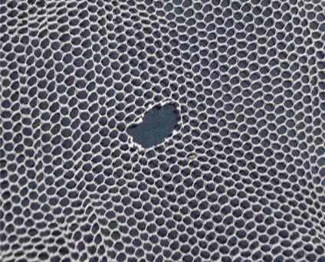
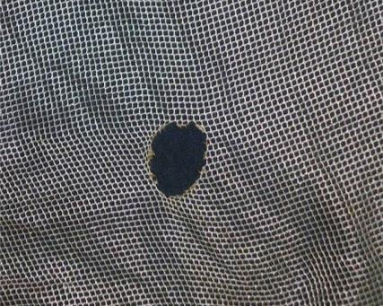
Burn Holes
Burn Hole (PE)
Burn Hole (PET)
Notes:
Image Albert Kilian / Malaria Consortium
Note the differences in the edges created by a burn on the PE net compared to the PET net. Note also the difference in texture of the nets themselves. Polyethylene (PE) (harder, rougher) and Polyester (PET) (softer)

Slide 18
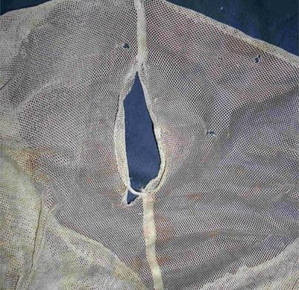
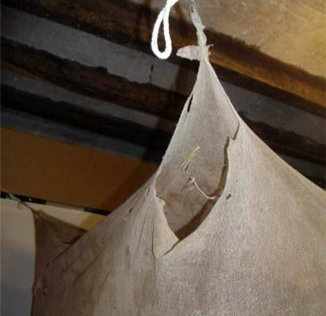
Tears
Open Seam Hole
Torn Corner Hole
Notes:
Image Albert Kilian / Malaria Consortium
Open seam holes are measured along the length of the opening.

Slide 19
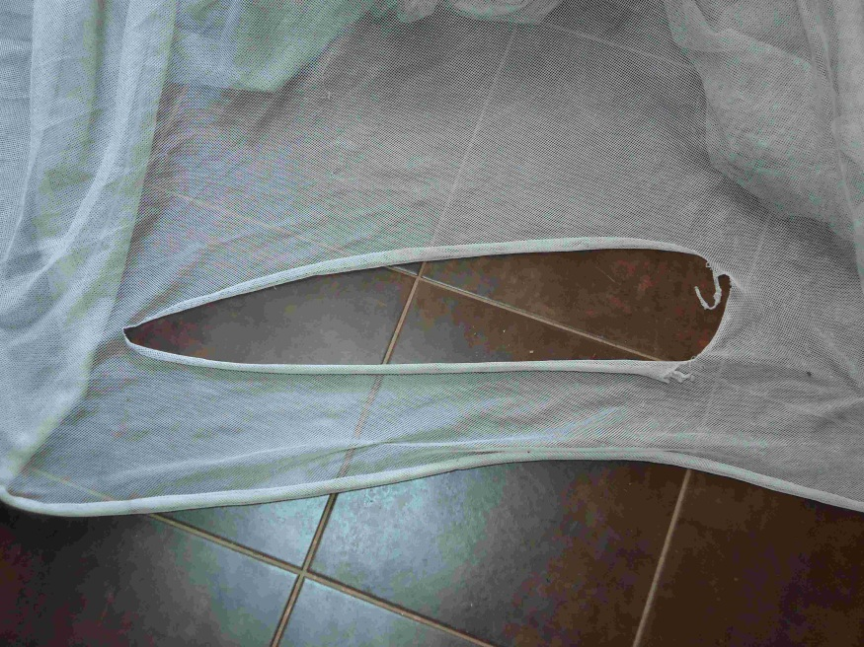
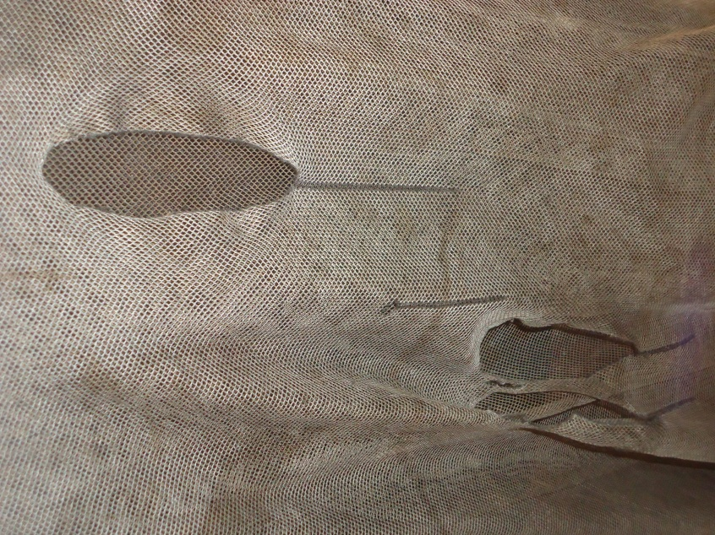
Tears
Notes:
Image Albert Kilian / Malaria Consortium
Open seam holes are measured along the length of the opening.

Slide 20
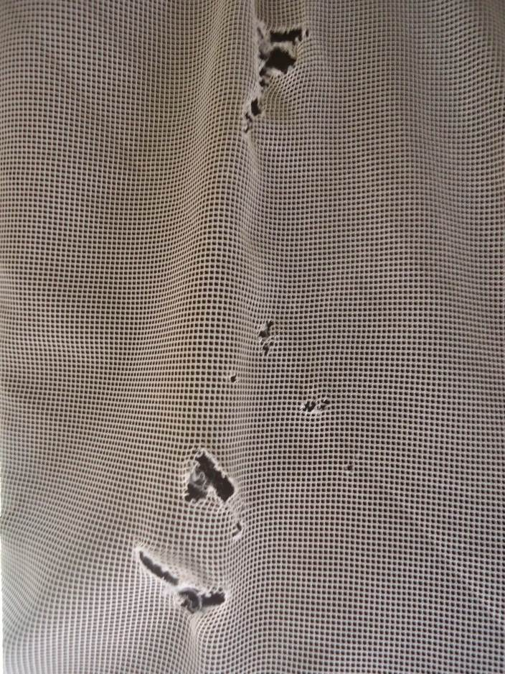

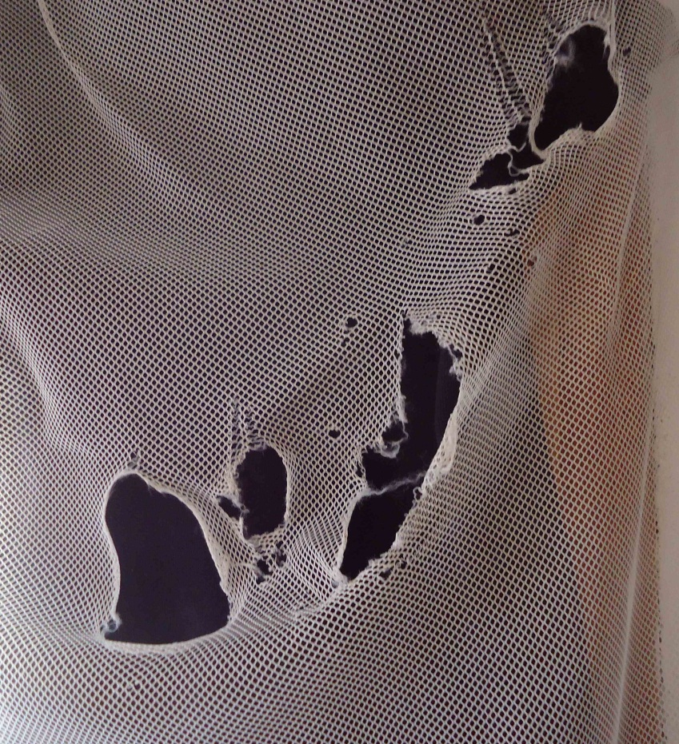
Rips and snags
April 2012
May 2012
February 2013
Notes:
This is an example showing how mechanical damage can progress over time when the net is repeatedly “rubbed” of an edge (here a balcony door)

Slide 21
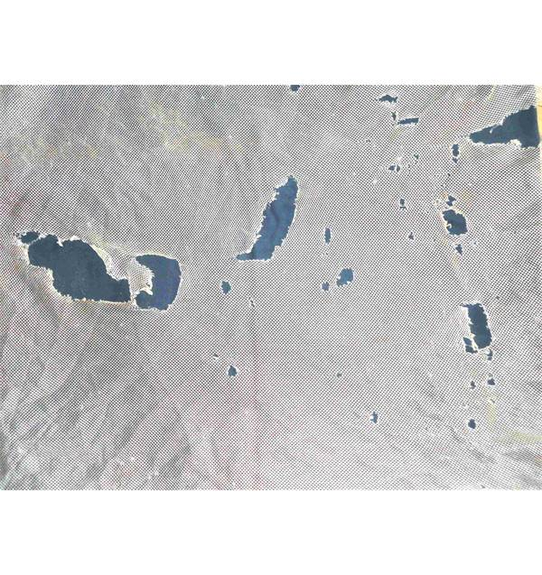
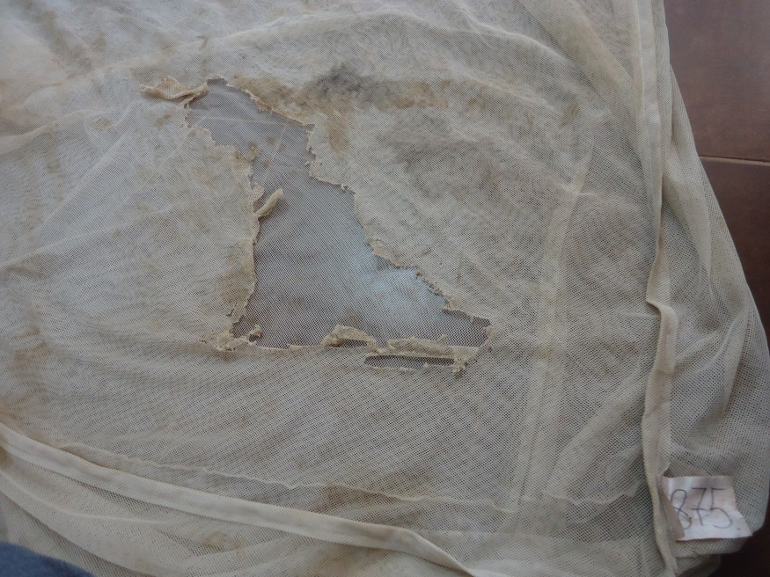
Rodent damage
Notes:
Rodent damage can be recognized by “fuzzy” edges and the missing of material which the mice or rats have “taken away”

Slide 22
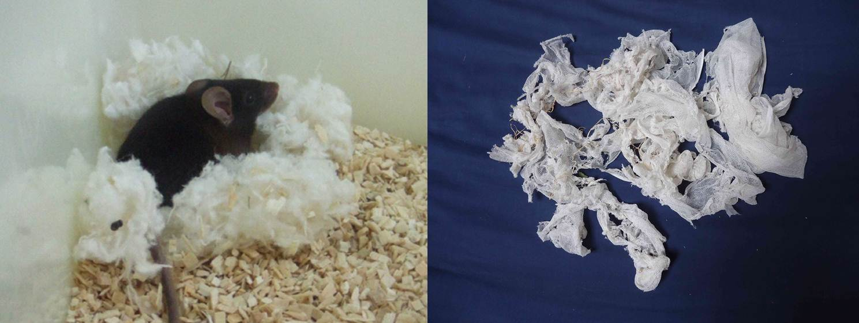
Rodent damage
Notes:
Rodents do not eat the netting material but rather use it for building their netst and to protect they young.
On the right you see netting material that was found in a “mouse house”

Slide 23
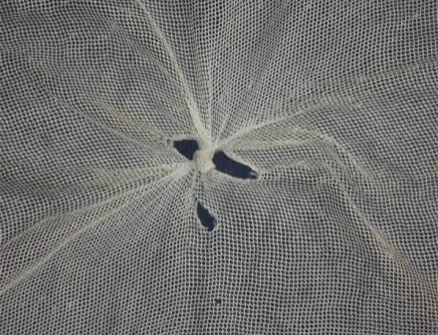
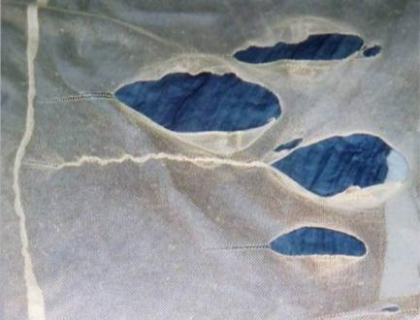
Partially Repaired Holes
Repair Knotting
Repair Stitching
Notes:
Images Albert Kilian / Malaria Consortium
Partially Repaired Holes: The hole assessment as the size remaining after the repairs. The example on the left would be assessed as three holes: two SIZE 1, one SIZE 2

Slide 24
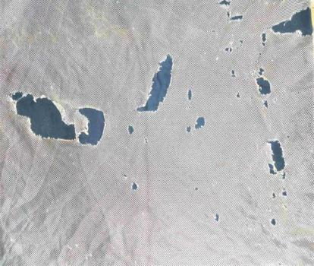

Multiple Holes
Notes:
Images Albert Kilian / Malaria Consortium
Multiple holes most likely from rats

Slide 25
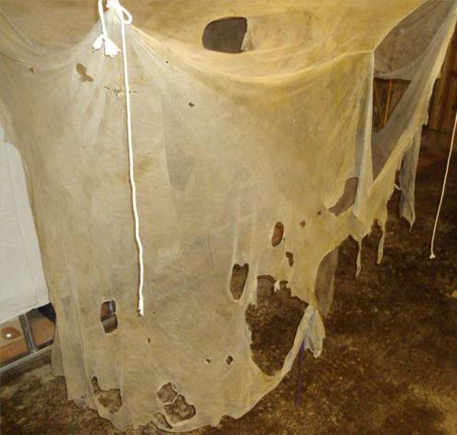
Huge Parts of The Net Missing
Notes:
Images Albert Kilian / Malaria Consortium
A “98” would be coded for SIZE 4 - Huge part of the LLIN missing.

Slide 26
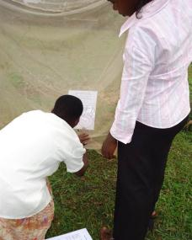
HOLE SIZES

Slide 27
Hole Size Categories
Category of Hole | Hole Size Description | Hole Size
Size 1 | Smaller than a thumb (finger) | 0.5 - 2 cm diameter
Size 2 | Larger than a thumb but smaller than fist (hand) | 2 - 10 cm diameter
Size 3 | Larger than a fist but smaller than a head (head) | 10 - 25 cm diameter
Size 4 | Larger than a head | > 25 cm diameter
World Health Organization. Guidelines for monitoring the durability of long-lasting insecticidal mosquito nets under operational conditions. (2011)
Notes:
To facilitate the hole assessment, a measuring template has been designed to help the surveyor measure the size of holes found. Net holes are measured in 4 categories, as recommended by the WHO Guidelines of LLIN durability monitoring.
World Health Organization. Guidelines for monitoring the durability of long-lasting insecticidal mosquito nets under operational conditions. (2011)

Slide 28
Hole Assessment Template
25 cm
If the hole is smaller than this, ignore
If the hole is larger than the line, it is SIZE 4
If the maximum length of the hole is more than the diameter of the large circle but less than the line it is SIZE 3
If the maximum length of the hole is more than the small circle but less than the large circle it is SIZE 1
10 cm
2 cm
If the maximum length of the hole is more than the small circle but less than the large circle it is SIZE 2
Notes:
The Hole Assessment Template is designed to help surveyors measure the size of different net holes and determine the size of each hole in a LLIN. The Hole Assessment Template contains diagrams of 3 circles that measure the exact diameter of the hole sizes. The template contains the diameter for hole size categories 1, 2. and 3. Size 4 holes are measured by using the length of the 25 cm line at the top of the template.
The Hole Assessment Template is printed and laminated on A4 paper. A copy of the template can found on page 4 of this Guide.

Slide 29
Special Recording
Open seams are treated as holes and measured by the length of the open area
A hole that is fully repaired (completely closed) is NOT counted as a hole
If large parts of the net are missing so that counting of size 4 holes is not possible the result is coded as 98 for size 4

Slide 30

Hole Tally Sheet

Slide 31
Hole Tally Sheet
Used to keep track of the total number of holes found on each side of the net
Useful when counting holes for LLINs with many holes
Divided by the five sections of the net:
  2 short sides, 2 long sides, and the roof
Each section has tally marks for all 4 hole size categories
Each hole size category has 20 circles that are filled in with each hole identified
Notes:
The Hole Tally Sheet is used to keep track of the total number of holes found on each side of the net. It is especially useful when counting holes for LLINs with many holes. When there are very few holes the counting is easy. Practice is necessary to develop expertise in accurately counting holes.
The Hole Tally Sheet is divided by the five sections of the net: 2 short sides; 2 long sides and the roof. Each section has tally marks for all 4 hole size categories. Each hole size category has 20 circles that are filled in with each hole identified.

Slide 32
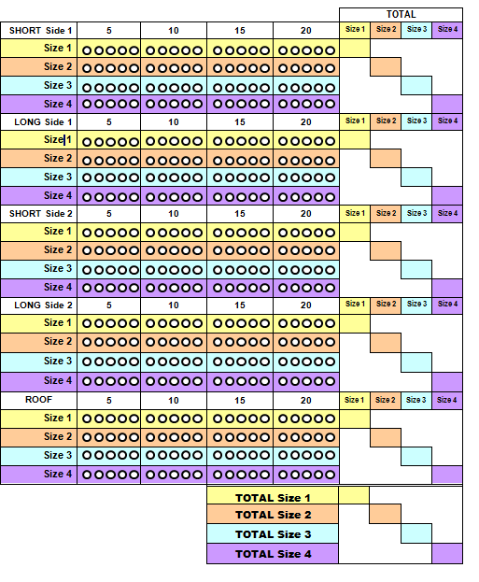
Hole Tally Sheet
Divided by the five sections of the net:
  - Short side 1 & 2
  - Long side 1 & 2
  - Roof
Each section has tally marks for all 4 hole size categories
Each hole size category has 20 circles that are filled in when each hole identified
Notes:
The Hole Tally Sheet is divided by the five sections of the net: 2 short sides, 2 long sides, and the roof. Each section has tally marks for all 4 hole size categories. Each hole size category has 20 circles that are filled in with each hole identified.

Slide 33
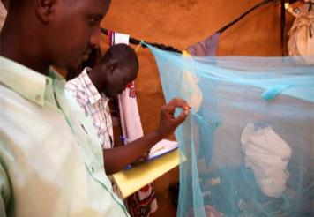
Hole Assessment Procedure

Slide 34
Hole Assessment Team
Work in teams of two surveyors
Household members assist in holding the nets by their corners
One surveyor is responsible for recording the number and size of the holes
The other surveyor is responsible for measuring and counting the holes

Slide 35
Step 1
Identify if the LLIN is hanging over the bed or sleeping place
Unfold or untie the LLIN so that all sides are easily visible, and holes can be easily counted and measured.
If the net is not hanging, take it to a place with sufficient room and light
Hold up by the "hanging loops"

Slide 36
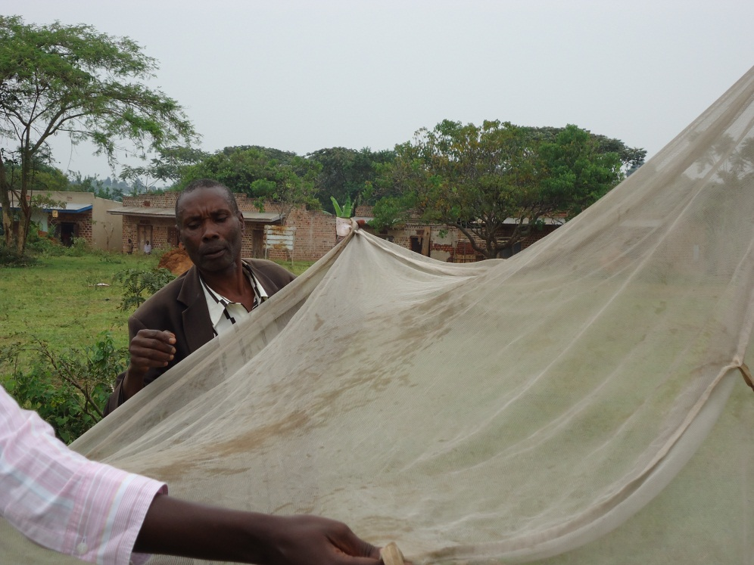
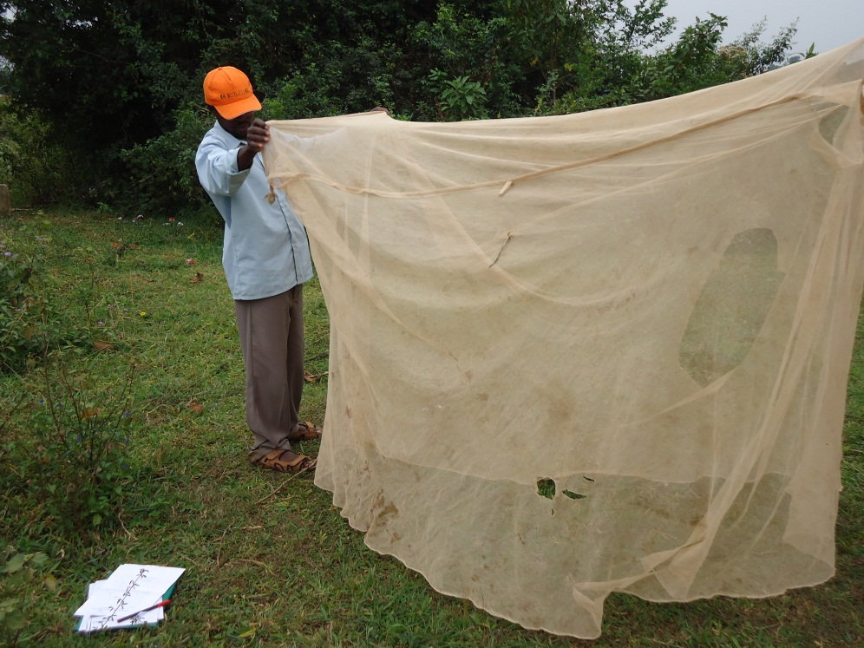
Step 1

Slide 37
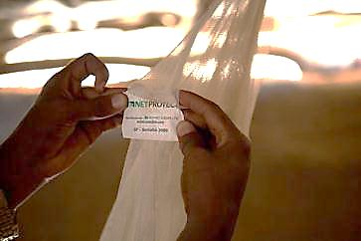
Step 2
Identify the LLIN brand name on the tag
Start the net inspection on the Short Side next to the net label
  For Conical nets start at the net tag and work your way around the net. Fill in only the first part of the tally sheet

Slide 38

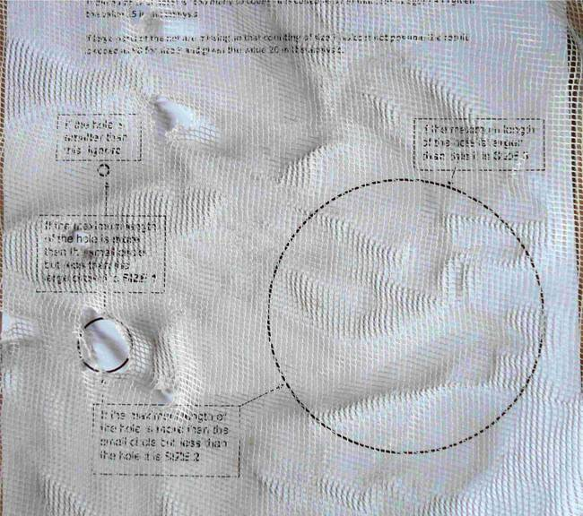
Step 3
Count the number of Size 1 holes on the short side of the net using the Hole Assessment Template by holding the template behind the hole

Slide 39
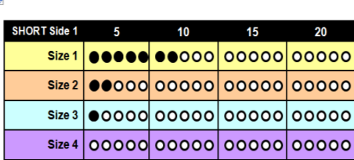
Step 3
Mark the number of Size 1 holes on the tally sheet by filling in the corresponding circle on the sheet

Slide 40
Step 4
Count the number of Size 2 holes on the same side
Count the number of Size 3 holes and then Size 4 holes
Mark the number of Size 2, 3 and 4 holes on the tally sheet by filling in the corresponding circle on the sheet

Slide 41
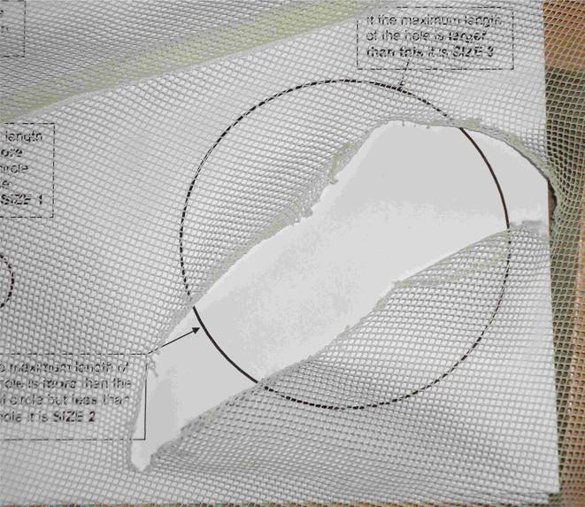
Maximum diameter counts

Slide 42
Step 5
Move to the Long Side of the LLIN (next to the net label)
Repeat the procedure for the Long Side
Make sure not to double count holes at the border between sides
Fill in the corresponding circles for the number of Size 1, 2, 3 and 4 holes on the tally sheet
Repeat the procedure for the other short and long side, and the roof

Slide 43
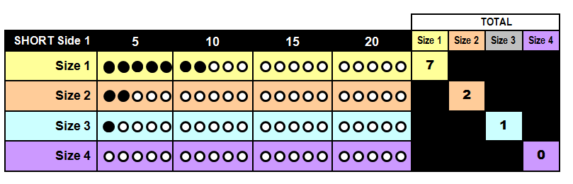
Step 6
When all sides are finished, count the total number of filled circles in each row (size category) for all five sections and enter the number in the “Total” box under each size

Slide 44
Step 7
Add up all Size 1, Size 2, Size 3 and Size 4 holes at the bottom right of the tally sheet
Record the total numbers on the LLIN durability questionnaire

Slide 45
Frequent challenges
Over-counting of small holes less than 0.5cm
Double counting of holes at the seam between short and long side
Overlooking single small hole
Overlooking single repaired hole

Slide 46
Survey Schedule
The number of households interviewed and LLINs assessed is dependent on:
Number of LLINs found in a household
The condition of an LLIN (the more holes the longer it will take to count)

Slide 47
Surveyor Responsibilities
Introduce themselves to the household and explaining the purpose of the survey
Inform household members that all information collected will remain confidential and that participation is completely voluntary, with no negative effects for non-participation
Obtain consent to enter the home and assess the nets
Ask the questions on the survey questionnaire and record the answers
Identify each LLIN in the household

Slide 48
Surveyor Responsibilities
Count the number of holes and determine their type.
Measure the size of each holes on each section of the LLIn
Record the number and size of holes on the assessment hole tally sheet
Respect the household members and their household property (LLINs)
Work together to support each other
Collect data that is VALID and ACCURATE

Slide 49
Materials For Surveyors
Blue pens (recording data)
Clipboard
Surveyor Job Aid
Laminated Hole Assessment Template
Laminated Hole Tally Sheet
Erasable Markers
Questionnaires
Bag to carry materials

Slide 50
Assessing LLINs Practice

Slide 51
Classroom Practice
Each team will pair up into 2 and practice counting holes on a minimum of 10 LLINs
Each surveyor will measure the holes of 5 LLINs
At the end of the practice session the hole tally sheets will be compared to the baseline
  checked for accuracy in counting holes
If the accuracy is poor (<75% accuracy) additional training on practice LLINs will be required before field practice
Notes:
Note the challenge is counting in the smaller sized SIZE 1 holes. There is usually more discrepancy in numbers recorded for these hole sizes, but it improves with practice.

Slide 52
Field Practice
Each group (A, B, and C) will be assigned to a different group of approximately 10 households each
Each pair will take turns surveying the same households in their assigned group
Households will be identified and compared by the name of the head of household
After all the pairs in the group have surveyed all the households in their group, they will meet to compare the results with the facilitator(s) and other pairs in their group

Slide 53
Field Practice (cont.)
If there are discrepancies in the number of holes for size 2-4 holes, the group of pairs will need to repeat the survey assessment for that household
  Counts should be within +/- 1 to maximum of 2
  Discrepancies for size 1 can be up to 5
If there are no discrepancies you will survey the next group of households and repeat the same process
All three groups (A, B, and C) will survey all three groups of households (total of approximately 15 households)
Each pair of surveyors is expected to assess a minimum of 15 LLINs

Slide 54
Field Practice Debrief
Flipchart paper
Group Name
Household
Name
Size 1
Size 2
Size 3
Size 4

