Slide 1

LLIN Durability Monitoring
Background and Objectives

Slide 2
Overview
Some background on malaria prevention with LLIN
Why is LLIN durability important?
What is durability?
How to measure it?
Why this study?

Slide 3
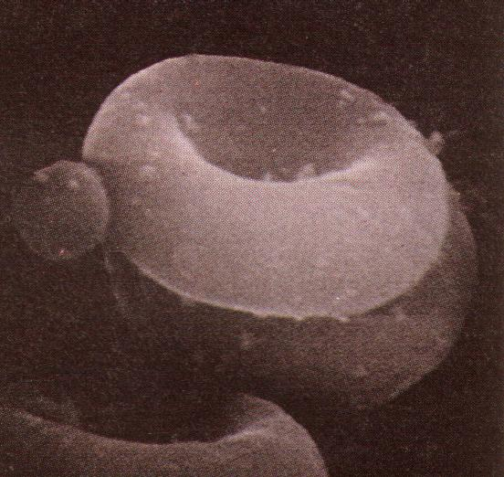
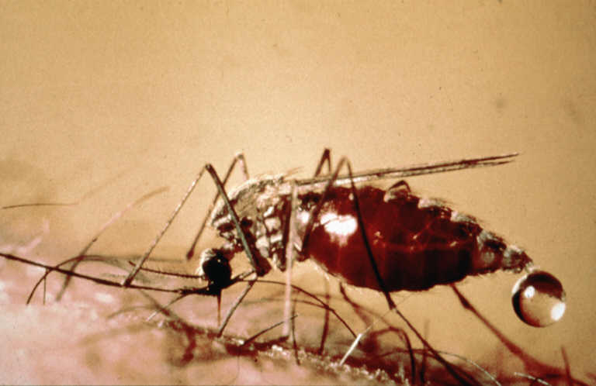
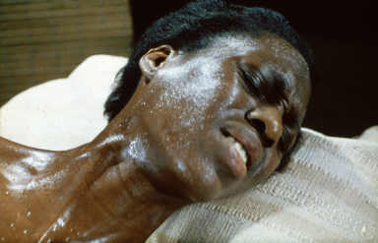
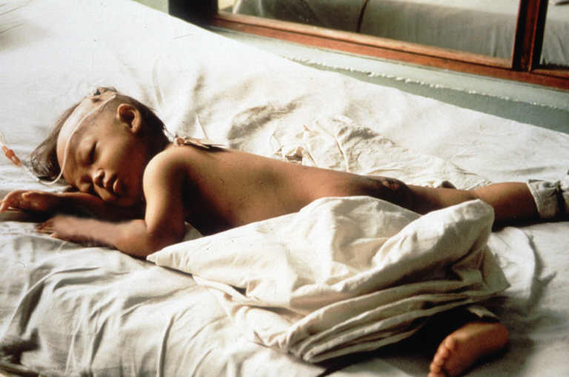
Determinants of Malaria
Parasite
Vector
Environment
Host
Notes:
Malaria is a parasitic infection and disease which has three major components:
The parasite of the family Plasmodium. There are five plasmodium species that infect humans: Plasmodium falciparum, malariae, vivax, ovale and knowlesi. The most dangerous parasite is P. falciparum of “tropical malaria” which is over 90% of malaria infections in Africa. In the picture (upper left) you see a P. falciparum parasite (the small “ball”) trying to enter a human red blood cell.
The vector or transmitting insect which in this case is a mosquito of the family Anopheles. Only female mosquitos bite humans and hence can transmit malaria and there are over 40 Anopheles species that are able to do so.
The human being which is the “host” of the parasite, i.e. the place where the adult parasite lives
These three factors interact with each other through the enviornment which means ecological (climate and biotope) as well as social (behavior of people)

Slide 4
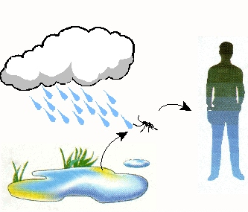
Options for Vector Control
The objective of integrated vector management is to reduce survival of the vector population to a degree that transmission is significantly reduced or interrupted
Indoor Residual Spraying
Adult mosquito Control
Insecticide Treated Net
Larval Control
Environmental Management
Protection from bites
Notes:
For the Anpheles vector to thrive and multiply in a given area, it needs water bodies suitable as breeding sites and a minimum in temperature and humidity. So following the rains the mosquito population will start to grow and the female mosquitoes will bite humans (they need the blood to develop their eggs) If a mosquito has bitten a human harboring malaria parasites and has taken up a male and a female parasite, they will “mate” within the mosquito and after a development of 7-10 days, the mosquito becomes “infective”, i.e. it is now able to infect another human when biting.
In order to control the malaria vector one can try to reduce the breeding sites (environmental management) or kill the mosquito larvae in the water (larval control) but in the case of the dominant vectors in Africa (An gambiae and funestus) this is very tricky as the vectors can breed in almost any little puddle. Therefore in Africa attepmts to control the adult, mosquitoes are more promising.
The two common measures for adult mosquito control are Indoor Residual Spraying (IRS) and Insecticide-Treated Nets (ITN). IRS works by putting an insecticide on the inside walls of houses so that AFTER the mosquito has biten a person and it rests on the walls to develop the eggs, it is killed. Therefore, IRS is not an idividual protection but only works when all houses in a community are sprayed (at least>85%) and the mosquito popiulation reduces and with it malaria transmission.
In contrast, ITN not only kill mosquitoes on contact, but also have a direct protective effect for the individual as they put a barrier between the human and the mosquito.

Slide 5
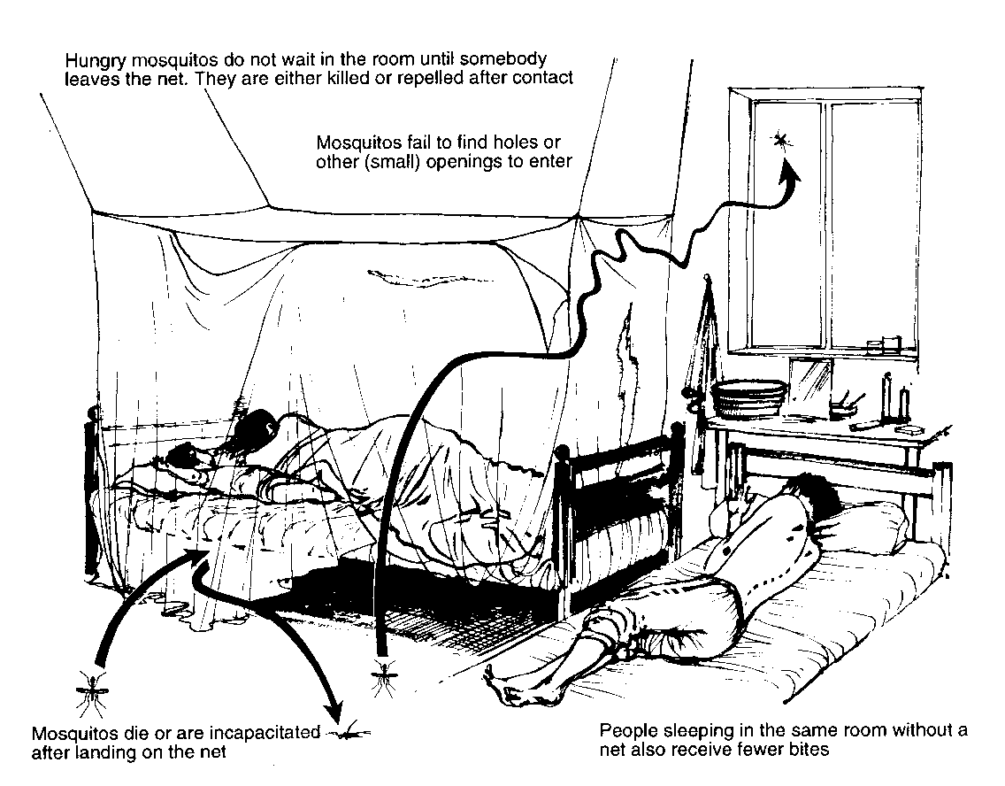
The principle of ITNs
Notes:
This picture explains the difference between an untreated net and an ITN.

Slide 6
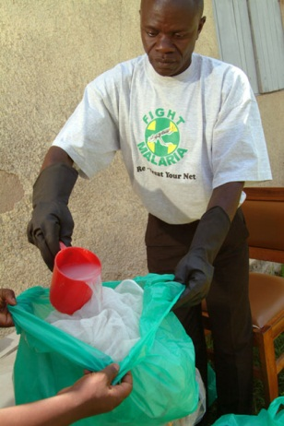
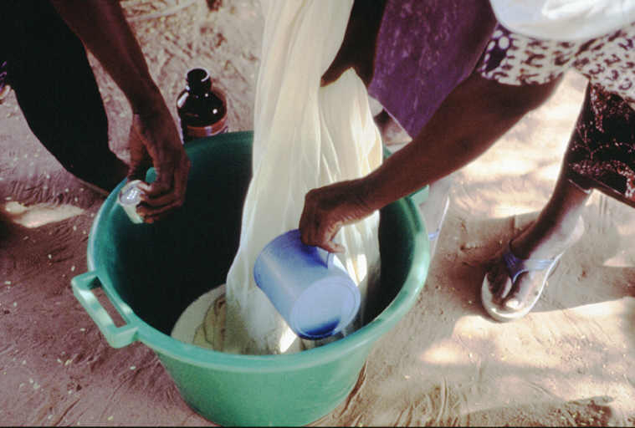
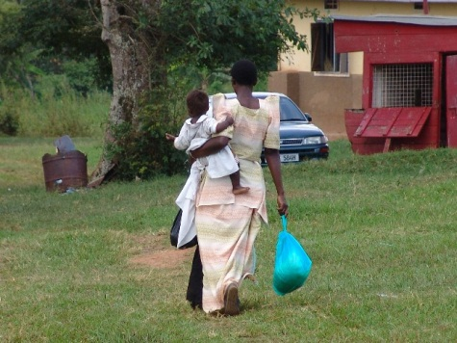
The LLIN Technology
Conventional ITN need re-treatment
Very difficult to maintain high re-treatment levels
The technology of long-lasting insecticidal nets (LLIN or LN) has made re-treatment redundant
LLIN made ITN suitable for mass application

Slide 7
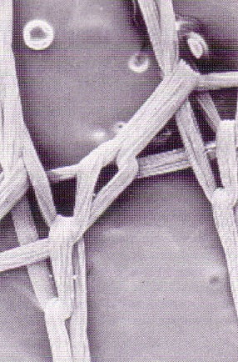
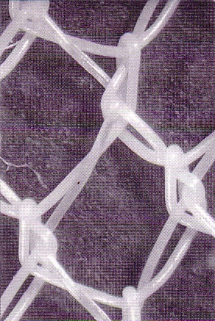
The netting materials for LLIN
Polyester
Polyethylene
Polypropylene

Slide 8
The working principle of polyester LLIN
Mosquito exposed to insecticide
Notes:
This series of automated slides show the principle how a “coated” polyester LLIN works.
The red/brown center is the polyester yarn and the yellow represents the “coating” which containes the insecticide molecules (cubes). Some insecticide is on the surface and will affect a mosquito yhat lands on the net, while most of the in secticide is in the coating where it serves a a reservoir.

Slide 9
Insecticide lost through washing

Slide 10
Insecticide lost through washing

Slide 11
Insecticide lost through washing
Notes:
When the mosquito net is washed, the insecticide on the surface is removed….

Slide 12
Insecticide lost through washing
Notes:
… and washed away

Slide 13
Regeneration after washing
Notes:
Now new insecticide from the reservoir will migrate to the survace to “retreat” the net from within

Slide 14
Gradual depletion of insecticide

Slide 15
Gradual depletion of insecticide

Slide 16
Gradual depletion of insecticide

Slide 17
Gradual depletion of insecticide
Notes:
This process is repeated until the reservoir is empty

Slide 18
Current LLIN Brands
Net/Brand | Material | Denier (fiber strength) | Mesh holes/sqr inch | Insecticide mg/sqr m
Olyset Net | Polyethylene | 150 | 75 | Permethrin 1000
Duranet MAGNet Royal Sentry MiraNet | Polyethylene | 145 | 132 | Alphacypermethrin 260
Netprotect IconLife PandaNet 2.0 | Polyethylene | 100-115 | 136 & 200 | Deltamethrin 63
Permanet 2.0 Yorkool Yahe | Polyester | 75, 100 | 156-177 | Deltamethrin 55
Interceptor SafeNet | Polyester | 75, 100 | 156-177 | Alphacypermethrin 200
Dawa Plus 2.0 | Polyester | 75, 100, 150 | 156-177 | Deltamethrin 80
LifeNet | Polypropylene | 110 | 156 | Deltamethrin 340
Olyset Plus | Polyethylene | 150 | 80 | Permethrin and PBO
PermaNet 3.0 | Polyester (sides) & polyethylene (roof) | 75, 100 | 156-177 | Deltamethrin and PBO
Veeralin | Polyethylene | 130 |  | Alpha-cypermethrin and PBO
Notes:
There are currently 17 different LLIN that have been recommended by the WHO Pesticide Evaluation Scheme (WHOPES) as suitable for use in public health. (updated May 2 2016). See http://www.who.int/whopes/en/ for the latest list.

Slide 19
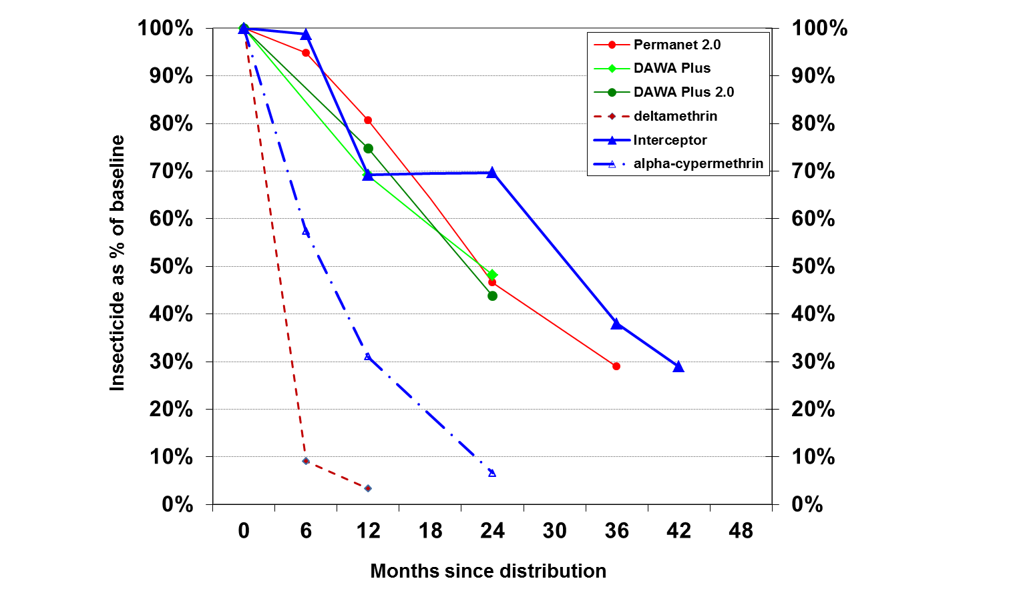
Current LLIN Brands
Given high loading doses in newer LLIN insecticide effect expected to last > 3yrs
Notes:
Data from studies (here an example from Uganda) suggest that with the current technology, the insecticide lasts for 3-5 years in most cases so that at the moment the physical durability of LLIN is of more concern than the insecticidal (but that may change in the future)

Slide 20
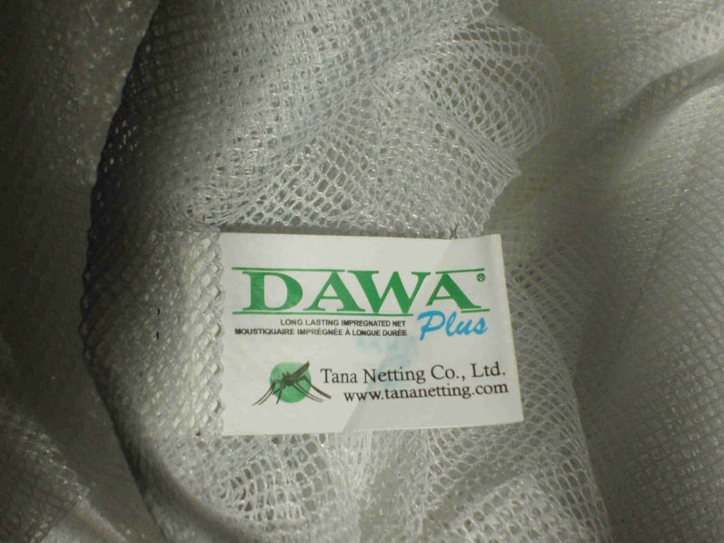
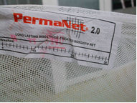
How to identify an LLIN
Since you cannot see the insecticide, the only way to identify an LLIN is by its brand label !!!!
Notes:
It is important to note that one cannot recognise an LLIN just by looking at it as it looks and feels like untreated nets. To identify an LLIN we have to check the label whether it is one of the WHOPES recommended brands or – if the label is lost – inquire from the owner what the label or package looked like. For this we use visual aids with pictures of all common LLIN.

Slide 21
Net and LLIN durability

Slide 22
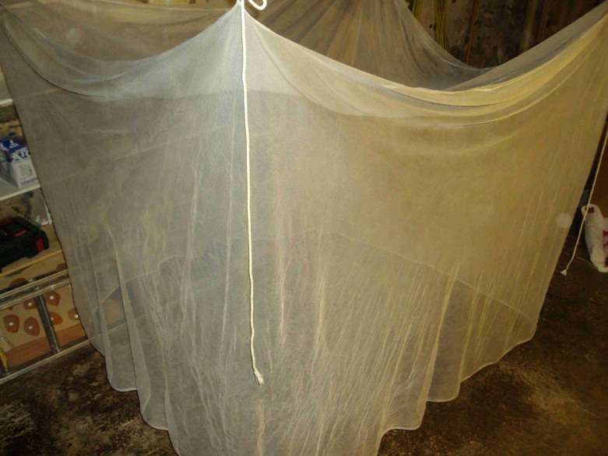
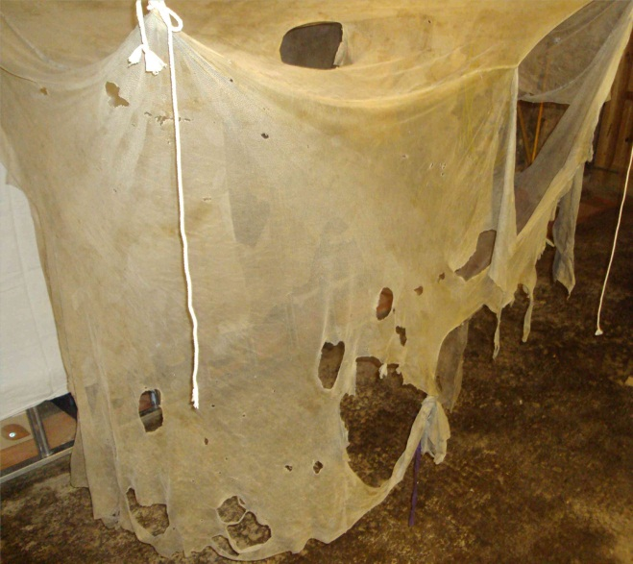
Stress on net varies
Between regions (environment)
Between households (socio-economic)
Between nets within household
Over the lifespan of the net
Notes:
To demonstrate how much the stresses on a net can vary you see here two nets of the same brand from a study in Uganda. Both nets have been used in the same village for three years, but by different households. One is almost as new while the other is all torn and not more than a rag….

Slide 23
What is LLIN durability?
Net durability
How long does the LLIN remain available to be used for sleeping under
  Retention/attrition
  Physical condition (integrity)
Insecticidal protection
When does an LLIN lose its ability to protect beyond just the net
  given the physical condition
Notes:
There are two main aspects of LLIN durability, the physical and the insecticidal

Slide 24
Why is LLIN durability important?
For many years the question “how long does an ITN last” was not relevant and therefore not asked
With the intensified scale-up the questions on how many nets will be needed to sustain success becomes critical

Slide 25
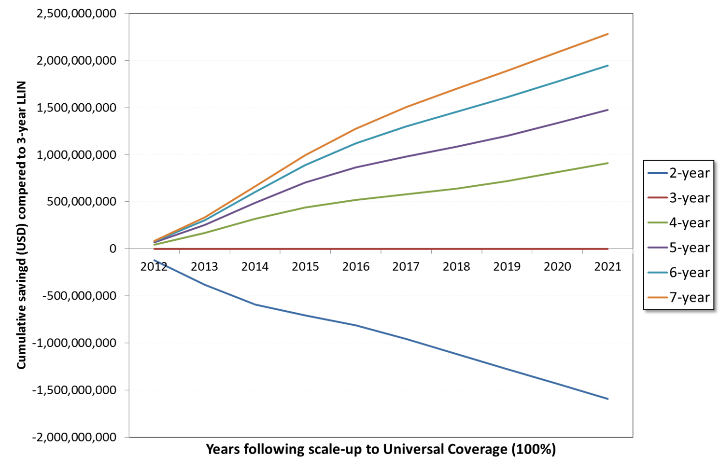
Why is LLIN durability important?
Potential savings from better LLIN
Notes:
These are results from modelling of the effect of a longer durability on the cost needed to sustain universal coverage with LLIN in Africa South of the Sahara
Compared to a “three year” LLIN (the red, flat line) a net that would last on average five years (purple line) would save about 1 billion $ in a period of five years (2012-2017). This is just to emphasize the financial implications of a more durable LLIN.

Slide 26
Are the nets still there?
Retention - Attrition
HH has net
Attrition Rate
Proportion Lost
loss function
Retention Rate
Proportion Retained
Net is gone
Time
Notes:
This slide is animated so you need to “click” your way through it.
Click 1-2-3: When we talk of attrition or retention we essentially refer to the observation that a household has a net and at a later point in time may no longer have it
Click 4-5: At population level we call the rate over time with which nets are lost the “loss function”
Click 6: The are above the curve then represents the propotion of nats lost a any given time or attrition rate
Click 7: .. And the area below is the inverse: the proportion retained or retention rate

Slide 27
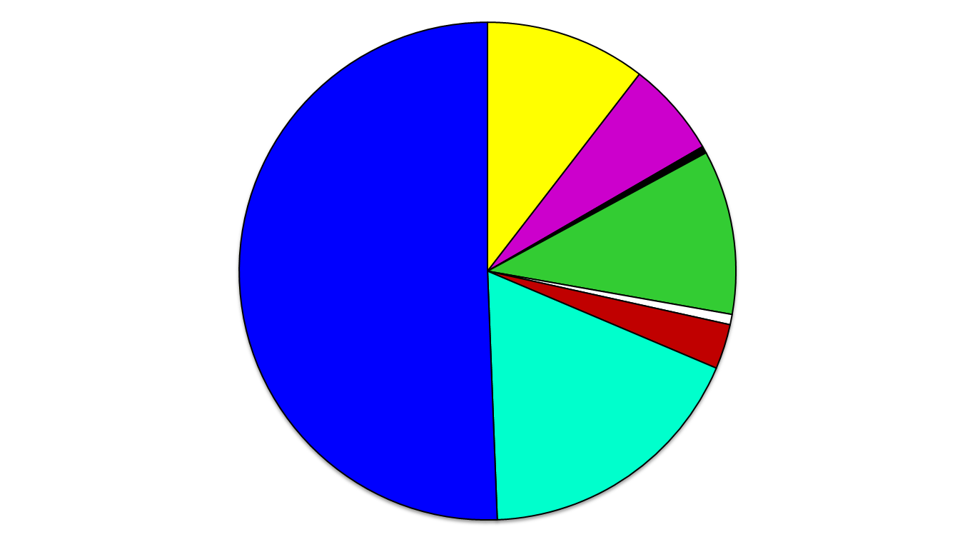
Net Attrition-Reasons for Net Loss
Kenya, 30 Months Post-Distribution
Destroyed-Burned by Fire
Discarded-Too Damaged
Discarded-Not killing
mosquitoes
Moved/Taken
from House
Sold/Given Away
Unable to Trace Net
Other
Lost/Stolen
Source: John Gimnig CDC
Notes:
There are many reasons why nets are lost as here shown from a PMI study in Kenya
But we can divide them into two major groups:
Nets that are given away for other to use including being stolen or sold, i.e. these nets are generally still in good shape
Nets that are lost because they are no longer considered “usable” doe to “wear and tear”: thrown away, discarded or used ofor alternative purposes

Slide 28
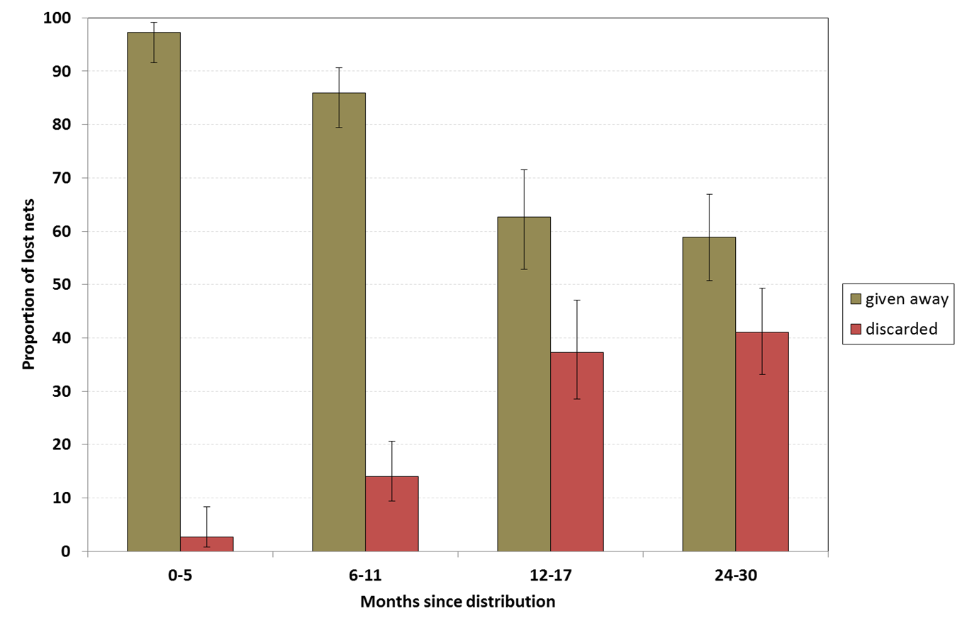
Attrition
Reason for loss from post-campaign and retrospective durability surveys in Nigeria (N=780)
Notes:
From past studies we know that immediately after distribution the overwhelming reason for loosing nets is “giving them away for other to use”
The proportion of nets discarded only increases slowly reaching about 40% of all nets after about two yesr. After that it tends to increase further to more than 50% until in the end most lost nets are discarded.
This means that it is always important to capture the resons for attrition to measure physical durability as thes given away in good condition have cannot be counted as “lost to wear and tear” (see later for the exact methodology)

Slide 29
Are surviving nets still OK?
Physical Condition
HH has net
Discarded nets not included
Surviving nets
Net is gone
Time
Notes:
When we next look at the physical condition or “integrity” of the nets we have to remind ourselves, that in a cross-sectional survey, i.e. a particular point on the time axis) we can only examine those nets that have survived up to this point, while those nets already lost and discarded, can no longer be inspected. This can have a significant impact on what we measure in integrity (see later slide)

Slide 30
How to measure integrity
Cross-sectional surveys
  Works initially
  But if nets are discarded at a certain state of destruction a steady state will be reached
Longitudinal study
  Preferable approach
  But more time consuming
Notes:
The second option is what we will do in this study

Slide 31
How to assess net condition
Classifying and counting holes
  Ideally done in lab on frame
  But not feasible in large field surveys as part of comprehensive questionnaires
  Need something more robust
Currently recommended classes
  Size 1: 0.5-2cm (thumb)
  Size 2: 2-10 cm (fist)
  Size 3: 10-25cm (head)
  Size 4: >25cm (larger than head)

Slide 32
How to get composite hole index
Need one overall measure of integrity
Weighted summary of holes of different sizes
Proportionate Hole Index
  Approximate measure of total hole surface
  Standardized approach
900 cm²
306 cm²
36 cm²
1.6 cm²
1
x # size 1 +
23
x # size 2 +
196
x # size 3
576
x # size 4
Notes:
As a overall measure of net integrity we first count the number of holes in each size category
Then we calculate the proportionate hole index by multiplying the number of holes with a weight for that size category and this weight is the ratio in size between that size category and the smallest size category. This means that the resulting sum (the PHI) is proportionate to the total surface area of holes in the net.

Slide 33
How to analyze hole index data
Need to categorize nets
  Good
  Damaged
  Torn
Serviceable
Current cut-offs recommended by WHO
  Good= <64 pHI or < 100cm² holes
  Max 2 size 2, none size 3
  Torn= > 642 pHI or > ~0.1m² holes
  More than 4 size 3 or 2 size 4
  Serviceable: <643 pHI
Notes:
So with the PHI we have a single “damage value” for each surviving net.
We now use cut-offs to divide different groups of nets in our study sample: those in good condition, those damaged and those considered too torn to be of further use. We call the good and damaged nets “serviceable” as we currently think that they are still safe to be used if there is enough insecticde on them.
The cut-off values in PHI are based on our current best estimates but may change in the future once we know more.

Slide 34
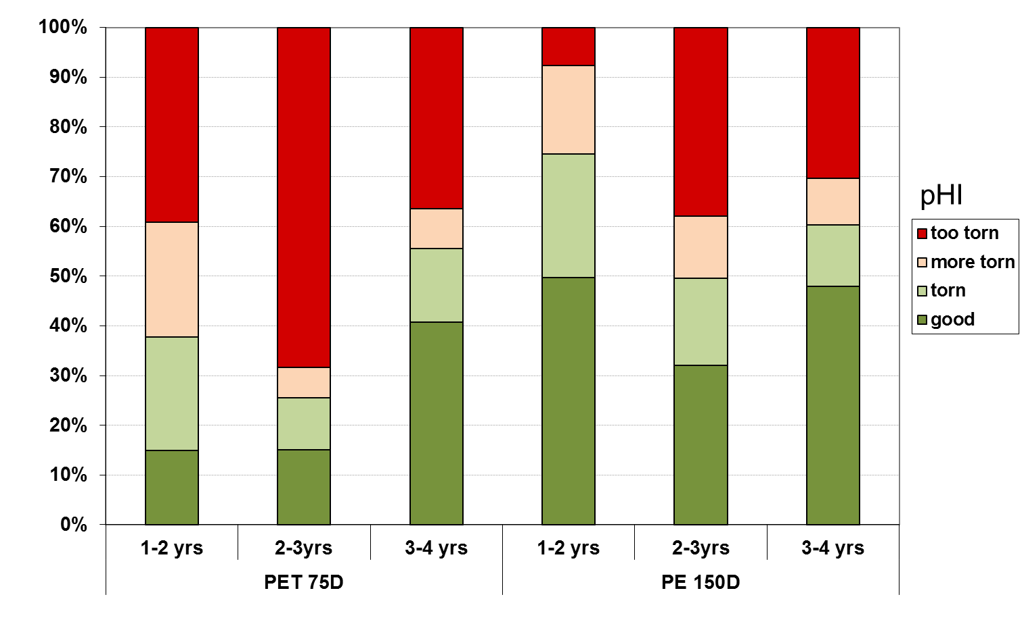
East Chad (MENTOR)
Notes:
It is critical that for physical durability always both aspect, attrition due to wear and tear AND physical integrity is measured and not only one or the other. This is demonstrated in this example using data from a study in Chad done by the Mentor Initionative (Richard Allan)
We see the physical integrity (here captures in four categories of PHI) over three surveys for two different types of LLIN: on the left a 75 denier polyester LLIN and on the right a 150 denier polyethylene net.
If we focus on the proportion of nets at each time point that were “too torn” (red section) we see for both types of nets that the situation deteriorated from year one to year two (as expected) but the significantly improved again in year three. This could look like the nets have become better again…. But it is wrong because we only look at the surviving nets!!! Between years 2 and three people started increasingly to discard the toen nets which were then no longer present in year three leading to the “improved” result.
This demonstrates nicely the need for measuring attirion AND integrity to get valid results of physical durability of LLIN.

Slide 35
How to combine attrition and integrity
Exclude nets given away or stolen (no outcome)
Nets thrown away, distroyed or used otherwise
Distributed
Lost
Lost
Lost
out
Still there
Still there
Still there
Too torn
Physical assessment of surviving nets
Survey after time X
Damaged
servicable
Fit for use
Good
From distribution list or recall
Denominator for durability (survival rate)
Durability or survival rate
Notes:
Based on all the elements, the recommended way to estimate the physical survival of an LLIN in a given location up to time X is shown here.
We first determine the nets originally distributed or identified as the study cohort.
Then we detrmine which nets are still there and how many were lost
From those lost we find out how many were given away to be used by others and these ar NOT considered in the calculation
From the surviving nets we determine the proprotion still in serviveable condition based on the measured PHI
Now we can calculate the survival rate…

Slide 36
How to combine attrition and integrity
# of nets still there and fit for use at time x
Durability =
# of nets originally received and not given away
Notes:
… by this formula where “fit for use” means “serviceable”.

Slide 37
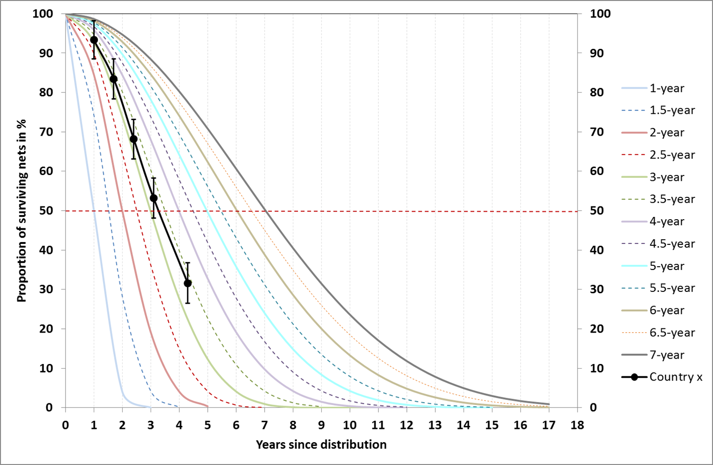
Plot survival outcome
Notes:
Now we can plot results from multiple time points against hypothetical “loss function” or survival curves.
The hypothetical survival curves are based on the S-shaped curve of survival backed by field evidence and an average (=median) survival of 3, 4 etc. Years. Data for this curve are fictional to demonstrate the use but similar real data exists

Slide 38
Estimating median survival
From at least 2 points of which the lowest should be 85% or lower
Time point | Time in years | Functional survival | Median survival using last two data points (95% CI)
1 | 1.0 | 93.3% | n.a.
2 | 1.7 | 83.4% | 4.1 (3.7 to 4.5)
3 | 2.4 | 68.2% | 3.2 (3.0 to 3.5)
4 | 3.1 | 53.2% | 3.3 (3.0 to 3.5)
5 | 4.3 | 31.6% | 3.3 (3.0 to 3.6)
Notes:
Once we have at least two suitable time points,
The table is based on the previous example of data

Slide 39
Why this study?
PMI guidance now includes routine durability monitoring
Collect LLIN durability data comparing different eco-geographical zones
Explore the potential of BCC on care & repair to increase durability

Slide 40
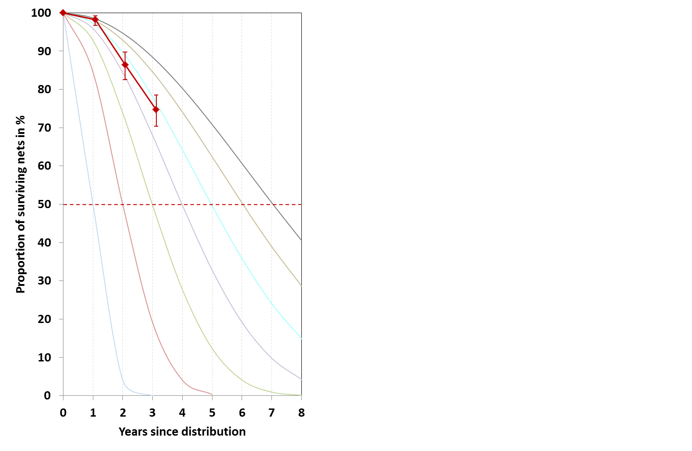
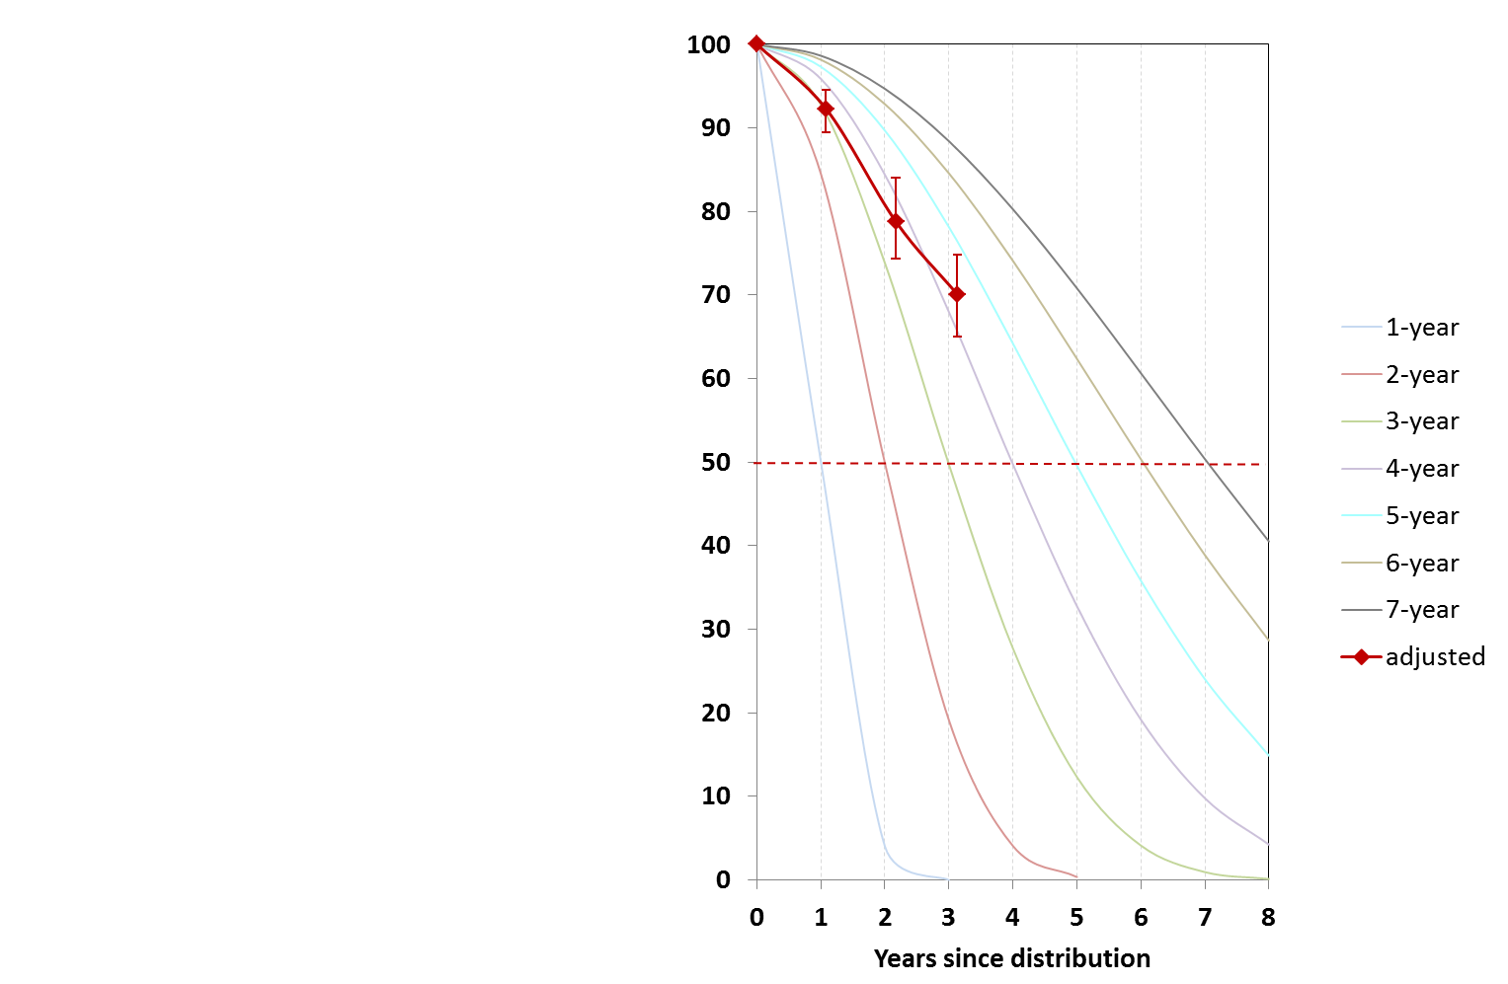
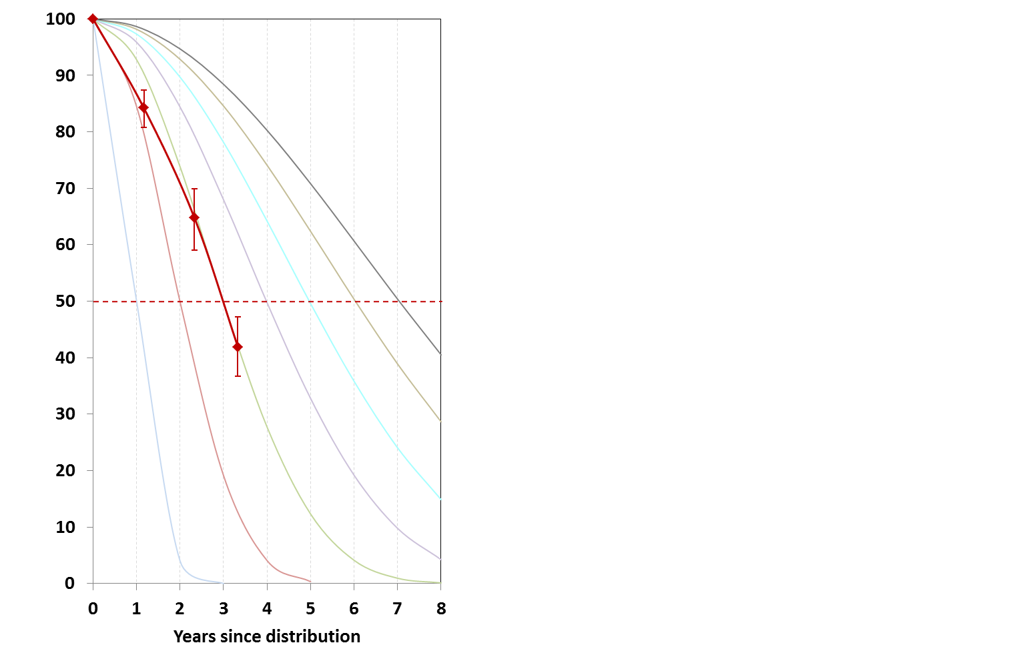
Durability - Survival
Zamfara
Nasarawa
Cross River
74.6%
39.5%
72.2%
Median
5.2 yrs
95% CI 4.8-5.8
Median
2.7 yrs
95% CI 2.5-2.8
Median
4.4 yrs
95% CI 3.6-5.5
Notes:
These results from a prevous durability study in Nigeria show how the data can be presented and what differences can be detected for the same type of LLIN in different environments and populations.

Slide 41
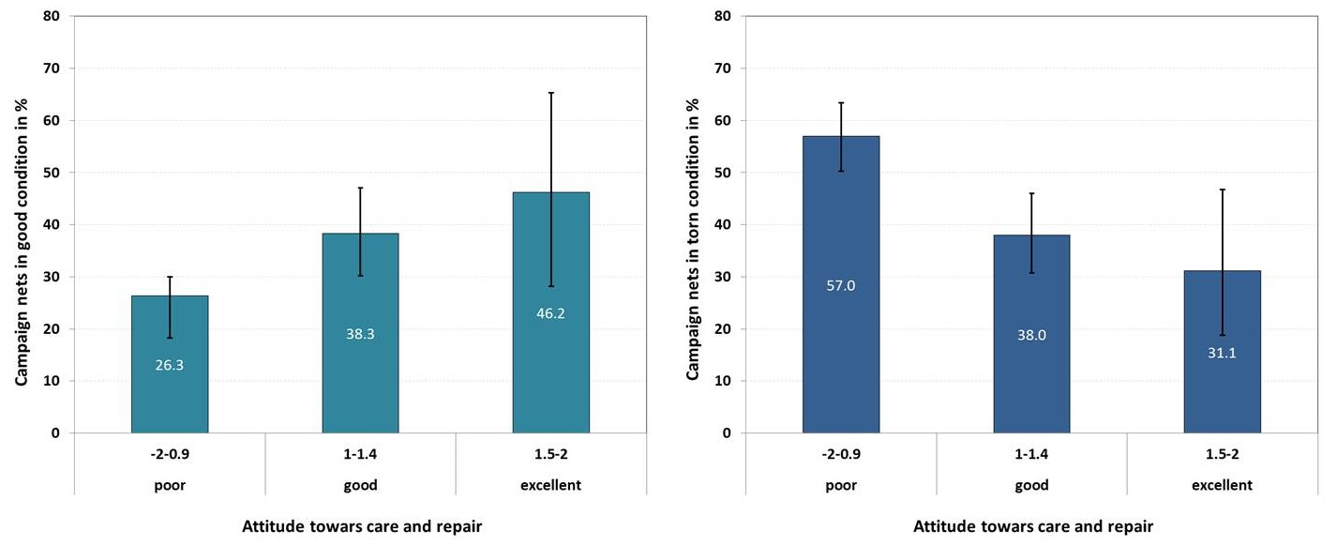
Impact: Positive attitude on behavior
Attitudes towards care and repair vs. net integrity
Good
Torn
Notes:
The Nigeria example also shows how the attitude of poeple towards care and repair is influencing their behavior and this attitude can be influenced by BCC. This is measured in the durability monitoring.

Slide 42
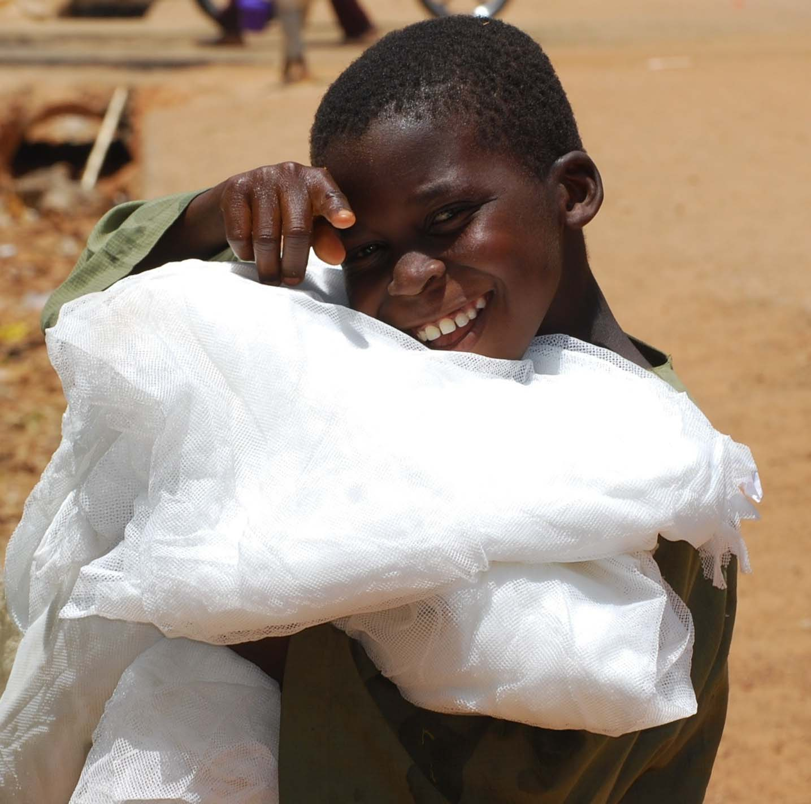
Thank You
Photo courtesy of Caroline Vanderick/SuNMaP

