Slide 1
LLIN Durability Monitoring
Household selection

Slide 2
Overview
Sectioning the settlement
Listing and numbering all eligible households
Selection of households with random number lists
Allocation of interviews and replacements

Slide 3
Sectioning a cluster
15 clusters have been selected per site
If the settlement has more than 200 households, it should be sectioned into equal part of about 60-100 households
These remain the same for all three survey rounds
Notes:
If the size of a cluster (village, community or census enumeration area) is not already known, the supervisor inquires from the local authorities the approximate size during the mobilization phase. If the size is more than 200 households, the community should be divided into 2 or more approximately equal sections. This is done because otherwise it would take too long to list all households and would require an additional day to cover that cluster.

Slide 4
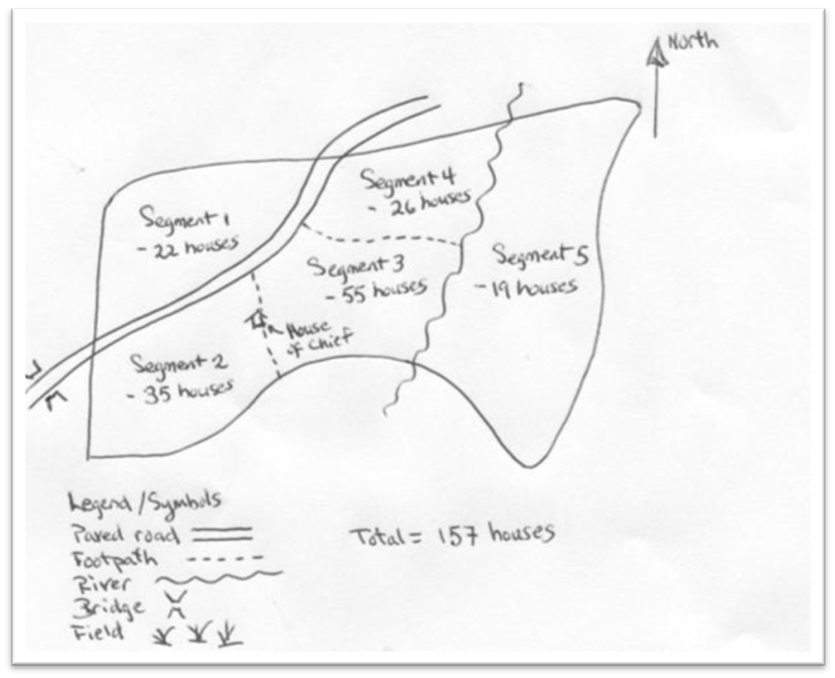
Sectioning a settlement
This should be done with local authorities or chief
Notes:
With the help of the local authorities or chief a rough sketch of a map of the area will be prepared, using either natural boundaries like roads or rivers or already exiting subunits in that community. This should be done in such a way that each section has not less than about 40-60 households.
Now one section will be selected randomly either by using small pieces of paper or asking a person not involved in the selection process. This selection can be done before the field visit or as the first thing when the team arrives in the cluster.
The supervisor now allocates a defined area within the community (or selected section) to each interviewer (plus local guide) and ensures that they have the household listing forms.

Slide 5
Listing of households
Within the settlement (or selected section) all households where people live are listed and given a household number
Excluded are
office buildings
Schools, health facilities
markets, trading centers
prisons, orphanages, barracks
any uninhabited other building
Notes:
Each interviewer visits all the inhabited households (i.e. where people live and some slept in the previous night) in the area he is allocated and lists name of head of household.
Exclusions will follow the rules used in the net distribution campaign, i.e. office buildings, schools, markets, health facilities, prisons, orphanages, and any uninhabited other building.

Slide 6
Listing of households
Each interviewer is allocated a part of the settlement (section) for listing
Each eligible household is given a unique number
The number has two parts
One digit for the interviewer (1-9)
Team 1: 1-3, team 2: 4-6, team 3: 7-9
Two digits for the household (01-99)
e.g. 101, 312, 645
Notes:
The supervisor will allocate interviwers to specific sections of the cluster (or the selected section of the cluster) making sure that borders of each interviewer’s area are clear and neither are houses missed nor are they double listed
Each interviewer has his/her own listing sheets and allocates the unique household numbers as follows:
The household ID number has three digits in total
The first digit is the interviewer’s number that has been allocated to him by the supervisor (1 to 9 for the three teams of three interviewers each)
The next two digits are a running number of the houses this interviewer has listed starting with 01 and going up to a maximum of 99. This means that each interviewer should have less than 100 houses to list
The total household number is then the three digit number as shown in the example

Slide 7
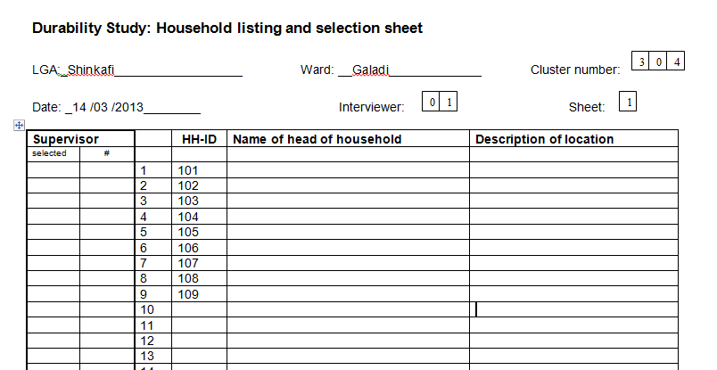
Listing of households
Notes:
Here an example is given for the first 9 houses listed by the first interviewer

Slide 8
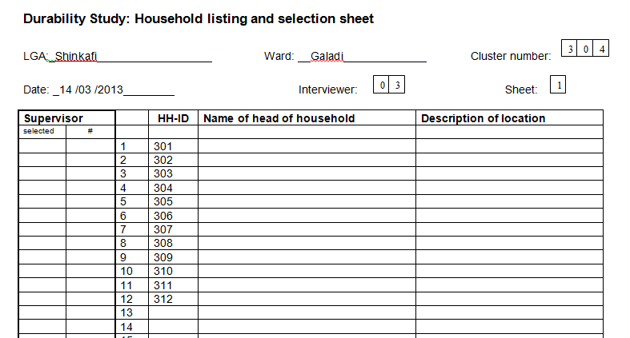
Listing of households
Notes:
And this would be the list for the third interviewer

Slide 9
Listing of households
Once all interviewers have completed their lists the supervisor merges them
In the column “supervisor (#)” of the household listing sheet he/she creates a running number including all households listed
The last number then is the total number of households listed
Notes:
The points of this slide are demonstrated in the next slide

Slide 10
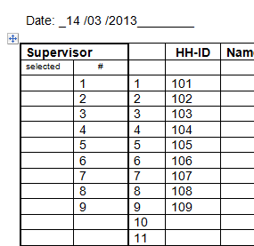
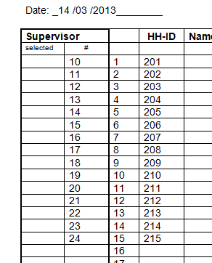
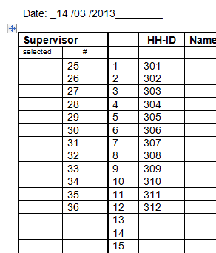
Listing of households
Notes:
Supervisor will “merge” the lists as follows: the supervisor sorts the lists by interviewer starting with interviewer one, then two etc. He/she fills a number in column "#" starting with "1" until he reaches the last entry of interviewer one. These numbers for the first interviewer are the same as the consecutive number in the unmarked column of the listing form.
For the second interviewer, the supervisor continues the numbering, i.e if interviewer one ended with 46, then the first number for interviewer two is 47 in column "#".
This means that the last number for the last interviewer is n, the total number of households listed.

Slide 11
Selection of households
The supervisor now looks up the number of listed households in the “random number list” under the column “listed hh”
The first 10 numbers in that row – columns 1-10 – are the selected households
The supervisor marks these on the listing form
Notes:
Again, the example in the next slide demonstrates the points made here

Slide 12
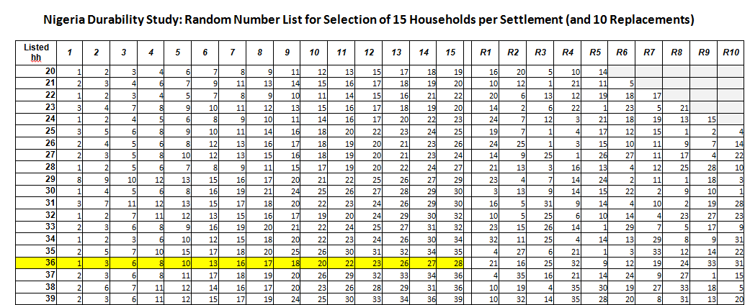
Selection of households
Notes:
The last number entered (n) is looked up in the first column of the random number table provided to the supervisor under "listed hh" which is the total number of households listed.
Let’s say that number is “36". Now you go across the row “36" and there are 15 columns labeled at the top as 1-15 which are the households to be sampled: 1, 3, 6, 8, 10, .... etc.
This refers to the cumulative list of households of column "#" in the listing form. So the supervisor marks that number with an "X" in the "selected" column of the listing form and those are the sampled households.
Note: This example is from an earlier study and, therefore, has 15 selected households. In our study we have 10!!!!

Slide 13
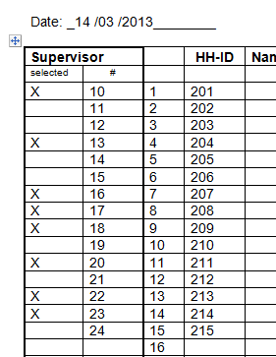
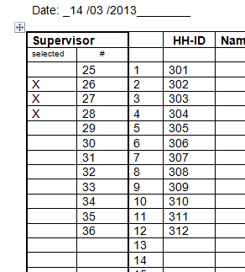
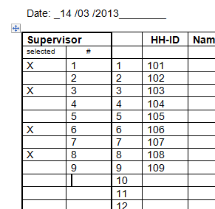
Selection of households
All selected households are visited by the team using the number under “HH-ID” as the household number on the questionnaire
Notes:
Here we see the completed list with selected households marked with the X in the “selected” column.
Imprtant: the ID number for the household to be entered into the questionnaire is NOT the running number in the supervisor/# column, but the number originally given by the interviewer during listing and entered in the “HH-ID” column (here marked with the red circle)

Slide 14
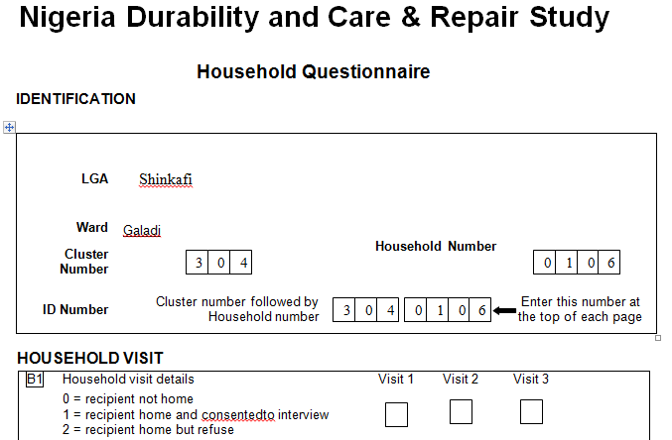
ID numbers of households
Notes:
The household ID entered on the questionnaire is the ID number given by the interviewer in the listing form.
It is important that on each questionnaire also the interviewer code is entered in order to distinguish potential duplicate HH-ID numbers within a cluster.
You see here that four digits are allowed for the household number. This is because due to replacements of interviewers, interviewer code may be 10 or higher. If the household number only has three digits, it is preceeded by a 0 as shown here.

Slide 15
Replacement of households
Selected households that are found not to be eligible because they did not receive any campaign nets are marked on the listing form by the interviewer (circle ID number)
After all 10 households are visited the supervisor selects the required number of households from the replacements R1-R6 from the random number list

Slide 16
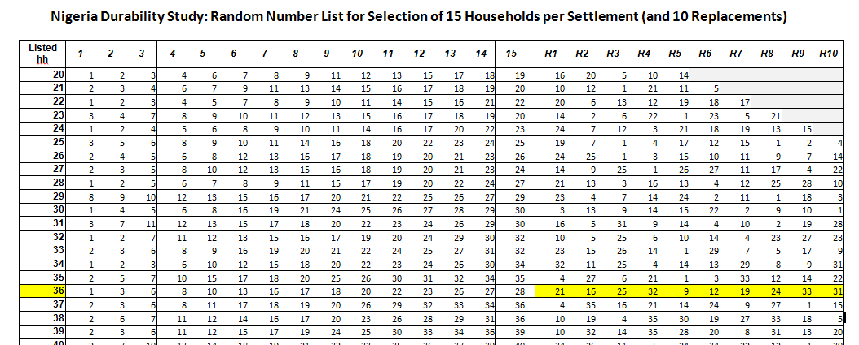
Replacement of households
Notes:
The row with the 36 total households in the “listed hh” column is used again, but this time only the replacements are used

Slide 17
Replacement of households
Replacement numbers are used in the order of ineligible households from left to right
If a replacement household is not eligible, it is NOT replaced
Not more than 10 replacements in total
Notes:
For example: if there is need for 5 replacements, the first five numbers (R1 to R5) from the random number table are used. They are allocated to the three interviewer teams and visited for interview.

Slide 18
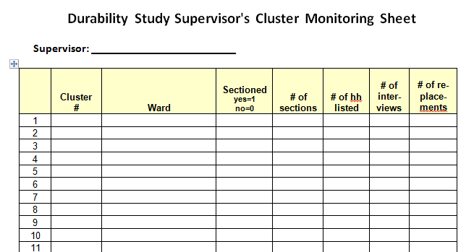
Summary of cluster results
After a cluster is finished the supervisor summarizes the results
Notes:
After the interviews are complete, the supervisor fills the Supervisor Cluster Monitoring Sheet with the details of that cluster. It is very important, that the number of replacements used is noted.

