Slide 1


LLIN Durability Monitoring
Capacity Building Workshop
PMI DM design, sample size and cluster sampling

Slide 2
Overview
The principle design and why it was chosen
Sample size and how to calculate variations
Sampling of clusters using PPS

Slide 3
Basic Requirement
Need unique starting point for measurement
  Distribution of nets by study team
  Use campaign distribution
Durability assessment not feasible for continuous distribution
For post-campaign DM need a representative sample of distributed nets

Slide 4

Early Design - WHOPES
WHOPES Phase III field trials
Focus on bio-assay and chemical residue
Not ideal for durability monitoring

Slide 5
Design options for Post-campaign
Prospective, longitudinal
Sample net cohort
Distribution
Assess
Assess
Assess
Prospective, cross-sectional (sub-population)
Distr. cohort tagged nets
Establish s.-frame
Distribution
Assess
Assess
Assess
Retrospective, cross-sectional
Recall for nets received, nets lost

Slide 6
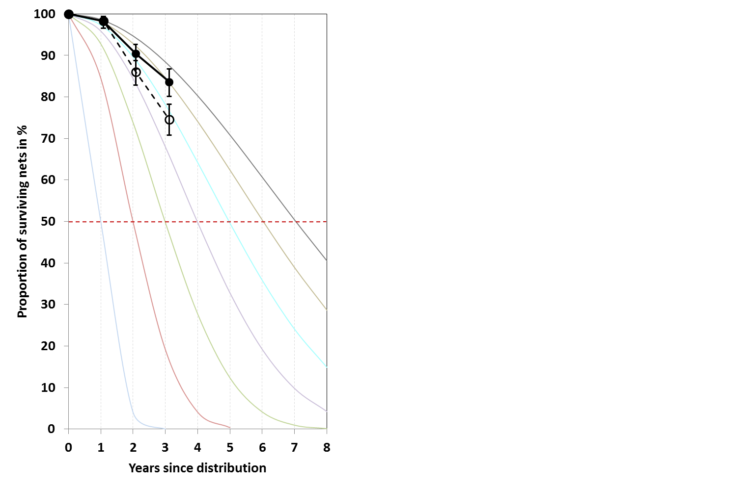
Design options for Post-campaign
Recall bias
Retrospective, cross-sectional
Recall for nets received, nets lost

Slide 7
Design options for Post-campaign
Prospective, longitudinal
Sample net cohort
Distribution
Assess
Assess
Assess
Prospective, cross-sectional (sub-population
Distr. cohort tagged nets
Establish s.-frame
Distribution
Assess
Assess
Assess
Hawthorne effect, but not important as both attrition and integrity are included

Slide 8
PMI guidance on DM
Prospective, longitudinal design
Representative sample
Baseline (establish cohort)
0
1-6
12
24
36
Distribution
Assess
Attrition
Integrity
Subsample:
Bio-assay
Assess
Attrition
Integrity
Subsample:
Bio-assay
Assess
Attrition
Integrity
Subsample:
Bio-assay
Assess
Attrition
Integrity
Subsample:
Bio-assay
Chemical residue
optional

Slide 9
PMI guidance on DM
Inform decisions on replacement of LLIN (intervel, strategy)
Identify LLIN brands with good or poor performance in the country
Highlight potential differences or trends in net care and repair behavior and inform BCC activities
Two options:
  Compare two different LLIN brands in similar environment
  Compare same LLIN brand in different environments

Slide 10
Sample Size

Slide 11
PMI DM Sample Size
  The standard recommended sample size is targeting a cohort of 345 campaign nets per site
  This is sufficient to detect a 18%-points difference from the expected 50% survival after three years comparing the best and the poorest performing site or brand
  It will be able to detect roughly a one year difference in median survival
  The representative sample of cohort nets is obtained through 150 households in 15 clusters under standatd assumptions of 5 people/HH and 1 LLIN per two people distributed

Slide 12
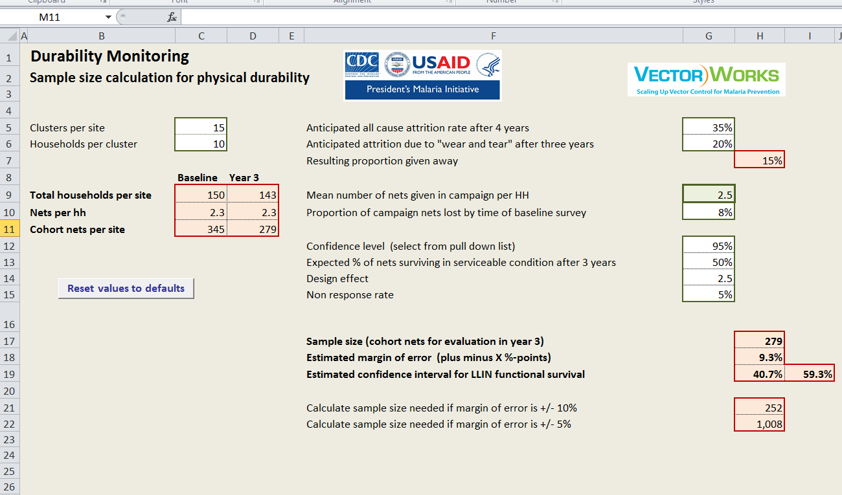
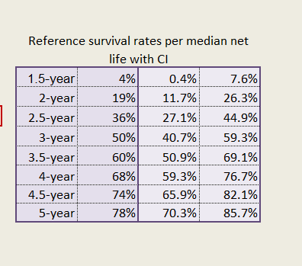
PMI DM Sample Size
  If standard assuption do not apply, sample size can be modified using the DM sample size calculator

Slide 13
Sampling of a representative cohort

Slide 14
Objective of Surveys
To obtain a representative estimate of the indicator of interest from the population at risk (or of interest)
….an unbiased picture of the “truth” without having to look at everybody or everything
Myth:
In order to be representative I need to include at least x% of my study population……..

Slide 15
Two Concepts
Accuracy
Precision
Is it an accurate picture of reality ?
How precise is my estimate ?
Representativeness
Repeatability
Sampling
Sample size Variation

Slide 16
Precision
Sample size
  The higher the sample size the better the precision
  Statistical significance does not always mean programmatic significance
  Even very small samples can be useful (LQAS)

Slide 17
Accuracy
Sampling
  If the studied items were homogeneous any sampling method will be accurate

Slide 18
Accuracy
Sampling
  But because they usually are not sampling is so important
  Ideally one would have a complete list of all study objects (sampling frame) and directly selects from the list the needed number
  If that is not possible sub-units of study objects can be selected (clusters)
    Health facilities
    Settlements
    Schools
  Two-stage cluster sampling

Slide 19
Cluster Sampling
First select the clusters (stage one)
And then the study objects in cluster (stage two)

Slide 20
Stage one
Whenever possible the first stage should be done from some kind of list using “Probability Proportionate to Size” or PPS
  Need list of clusters and any measure of size
  PPS is a systematic sampling which allocates more units where more people are living
  We have an excellent tool for a semi-automatic selection of clusters (adapted from a tool developed by statisticians at LSTMH)

Slide 21
Principle of PPS sampling
Obtain a sampling frame of every possible cluster (e.g. village) with some measure of size
  Registration or micro-planning list by village from campaign
Create a cumulative list of the “size”
Divide cumulative total by n=number of desired clusters > this is k, the sampling interval
Randomly find a number between 1 and k, this is the starting point > the village where the selected “size” is found is selected as first cluster
Now add the k interval to select the remaining clusters

Slide 22
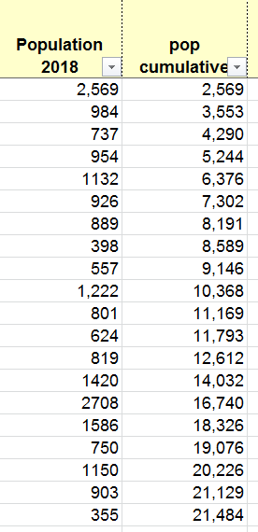
Principle of PPS sampling
k= 21,484/15=1,432
1st cluster
2nd cluster
3rd cluster
Random number 1-1,432
= 1,251
4th cluster
Start +k
1,251+1,432=2,683
Last +k
2,683+1,432=4,115
Last +k
4,115+1,432=5,547

Slide 23
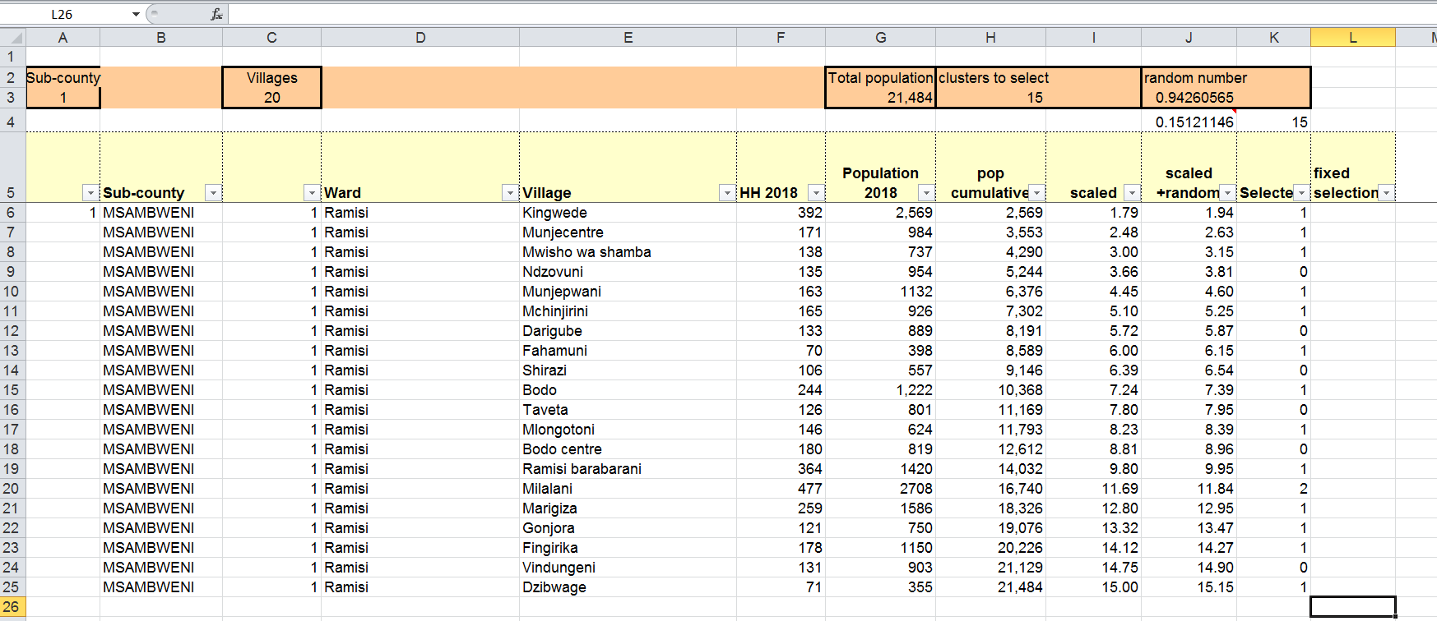
Cluster Sampling Tool
Data entered from sampling frame
Data produced by tool

Slide 24
Cluster Sampling Tool
Step 1: create cumulative list of “size”, here population

Slide 25
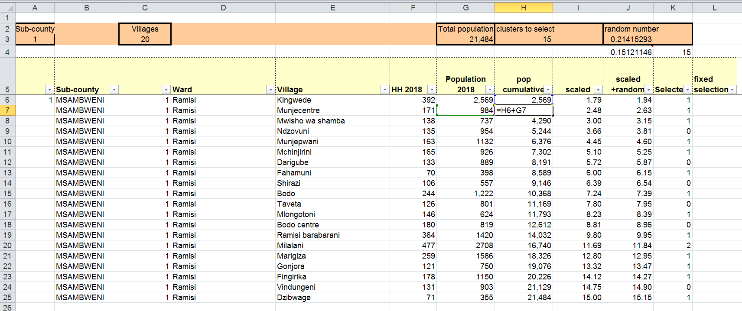

Cluster Sampling Tool

Slide 26

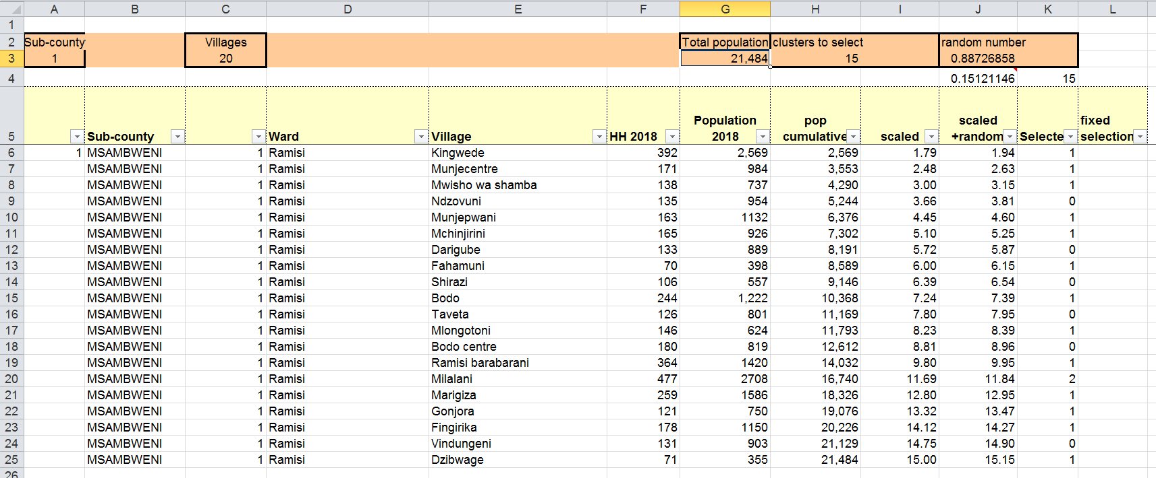
Cluster Sampling Tool
Step 2: make sure the sub-total of “size” is set correctly (default=495 rows of data)

Slide 27
Cluster Sampling Tool
Step 5: set the number of clusters you want, here 15

Slide 28
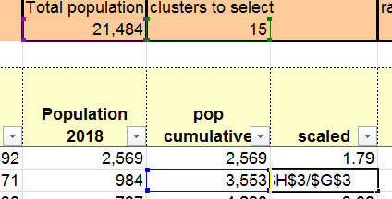
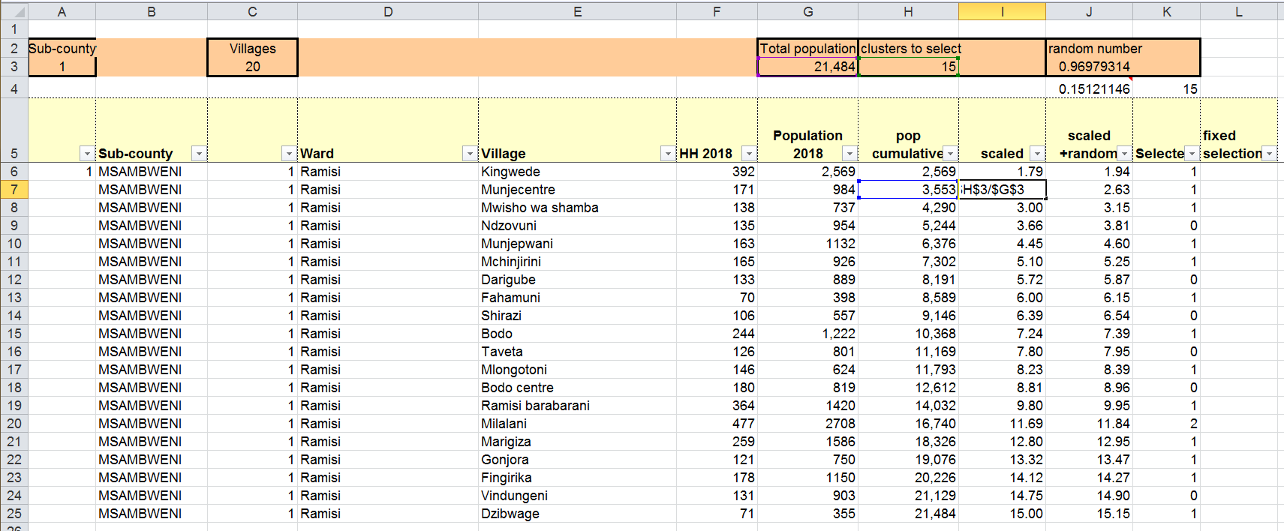
Cluster Sampling Tool
Step 6: a scaled cumulative “size” is created that is scaled to the number of clusters selected:
cumulative total in row/total*# of clusters

Slide 29

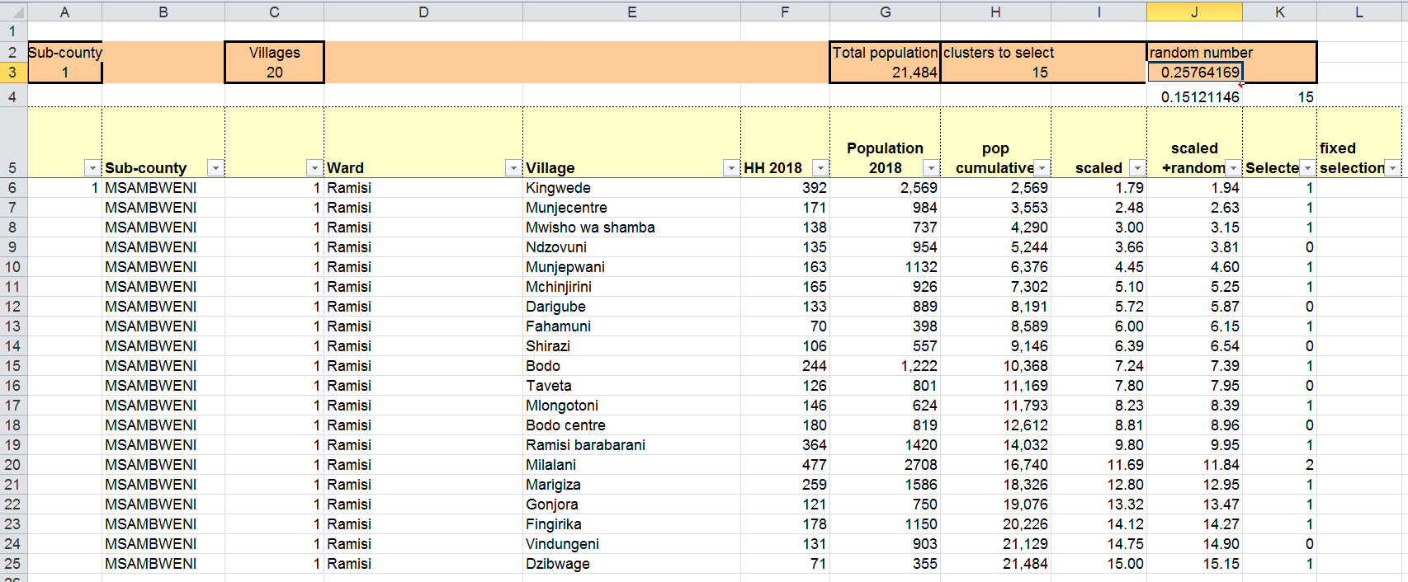

Cluster Sampling Tool
Step 7: next a random number between 0 and 1 is selected as starting point, copied to a “fixed” field (paste > value only!) and added to the first scaled value

Slide 30
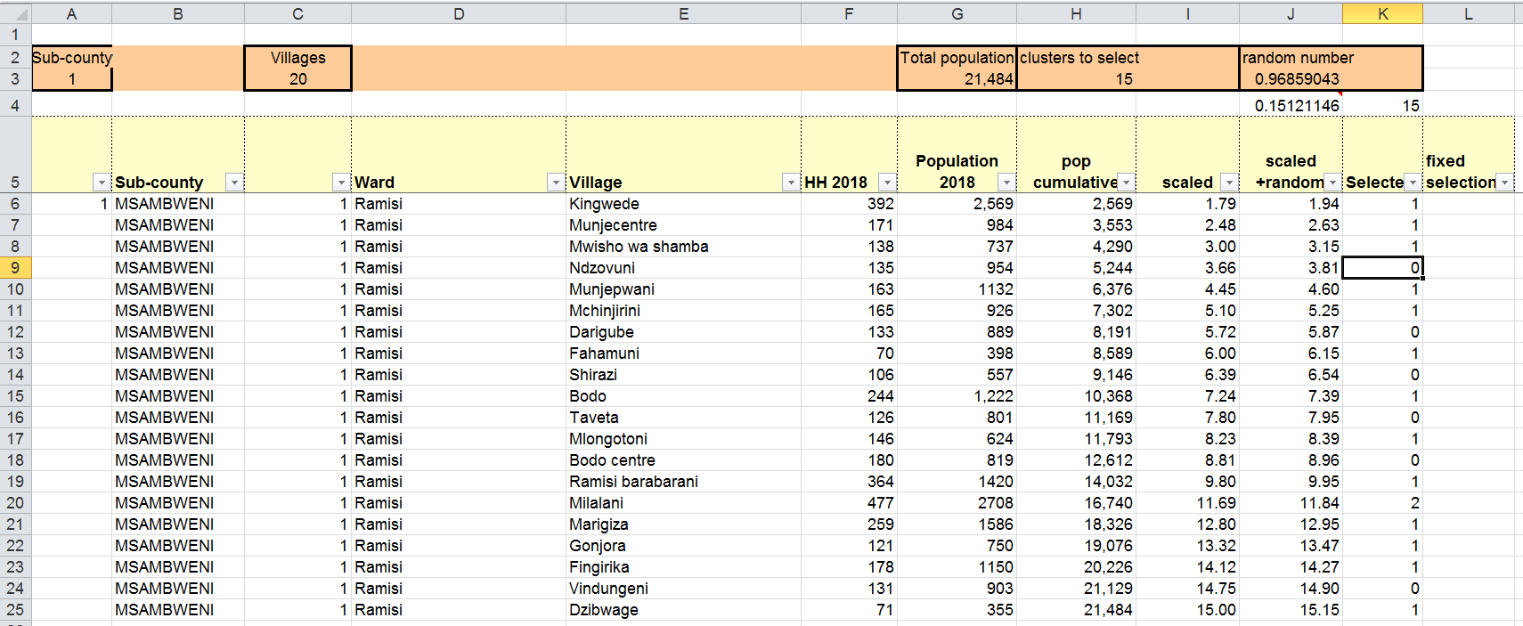

Cluster Sampling Tool
Step 8: now a selection of clusters by PPS can be made by determining each time the scaled + random changes the integer

Slide 31
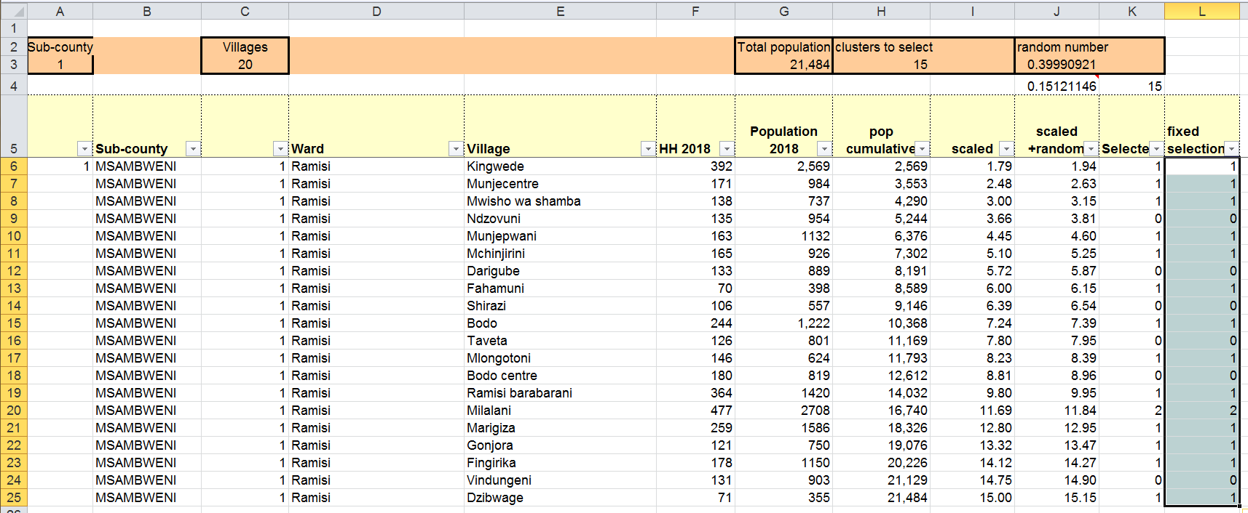
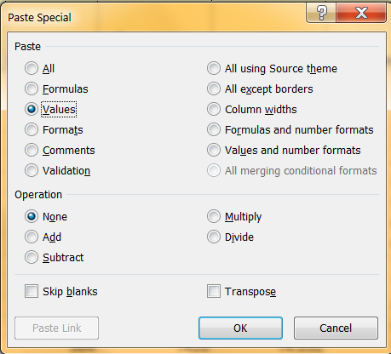
Cluster Sampling Tool
Step 9: we now want to filter for the selected clusters. In order to do that we need to copy-paste the selection into a “fixed” column using “values only”

Slide 32
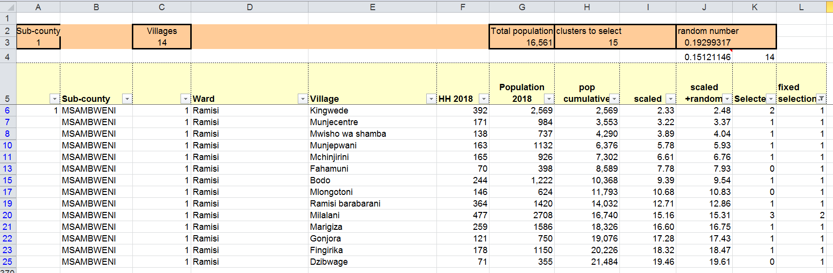
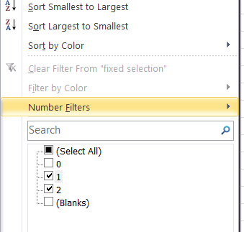
Cluster Sampling Tool
Step 10: using the “filter option” select all values >0 in “

Slide 33
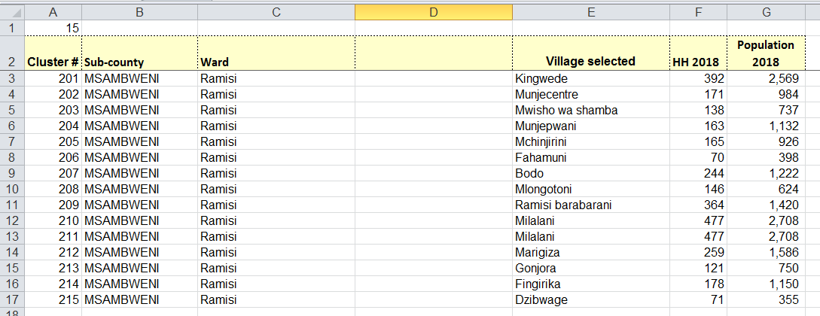
Cluster Sampling Tool
Step 11: Finally, the selected clusters are copy-pasted into a new sheet called “selected clusters” and given a cluster number 101-115 for site 1 and 201-215 for site 2

Slide 34
What to do when sampling frame at cluster level is not available?
Often lists from campaigns (micro-planning, registration or distribution) are only available at a higher administrative level (Health facility catchment area, DP or ward etc.)
In this case the PPS is done as described but at the higher level
  May result in multiple clusters allocated to one unit
In a second step a list of all possible clusters (villages or communities) of the selected higher level units are compiled and clusters are selected using simple random sampling

Slide 35
Exercise
In the materials under “sample size and cluster sampling” you will find
  The DM sample size tool (file 2h…)
  PPS cluster sampling tool.xlsx
    The tool not yet filled
  Sampling frame data.xlsx
    Example sample frame from Kenya
  Filled PPS cluster sampling too as Example.xlsx
    The tool filled with the Kenya data to see what it should look like

Slide 36
Exercise (2)
Open the sample size calculator and adjust sample size for a situation where mean household size is only 4.0 but we still need at least 345 cohort nets at baseline
Use the PPS sampling tool and the Kenya sampling frame data to make a PPS selection of 15 clusters and copy them to the “selected clusters” sheet
Play around with the tool so you understand how it works

